Slide 1
Welcome to 2022!
https://www.insurance.wa.gov/medicare-advantage-plans-part-c
Medicare Advantage OEP
January 2022 continuing education
Created Dec. 22, 2021
Notes:
SHIBA trainers
January 2022 training will focus on the Medicare Advantage Open Enrollment Period (MA OEP).
Suggested Learning objectives:
Medicare Advantage Open Enrollment
What should happen in 60 minutes training time and what are design considerations?
Focus on building knowledge, skills/abilities, use of tools – training should simulate real-life experiences.
This is pro-social – volunteers interact with each other.

Slide 2
Agenda
Welcome to 2022!
Medicare Advantage Open Enrollment Period
Job aids and resources
Wrap-up
January learning objectives
Describe what can be done during MA OEP counseling.
Demonstrate where to find resources to answer client questions regarding MA OEP.
Notes:
SHIBA trainers
Learning objectives for January 2022 CE:
1. Describe what can be done during MA OEP counseling.
2. Demonstrate where to find resources to answer client questions regarding MA OEP.
Clickable images:
From the PowerPoint, you may need to mouse-over the image, right click, select Open Link and the file should launch.
From the PDF of the PowerPoint, mouse-over the image and click. The file should launch.

Slide 3
Medicare Advantage OEP
Notes:
Trainer notes ideas
Transitioning from OEP to MA OEP: What it is and who’s most impacted?
Covering a lesson on the topic and then spending remainder of CE time on case work discussion.
MA OEP suggested training:
“Whew we made it to the end annual open enrollment. Give yourself a pat on the back to helping so many beneficiaries this year. (Maybe have some basic stats like 1000 beneficiaries helped in Spokane.)
Now that we have begun a new year, we take a look at MA open enrollment which falls between January and March. Let’s look at the enrollment period, who it’s for, the choices available and how we can help consumers.
Give a short (suggestion could be 20-30 min) lesson on MA OEP. Following the lesson, have the group work through 2-3 cases asking different volunteers to take lead on how they would work the case and inviting new volunteers to ask questions about the cases that may be confusing, need clarifying or direction from point of view of someone totally new to Medicare counseling.
Resource Medicare.gov: https://www.medicare.gov/blog/medicare-advantage-open-enrollment
Discuss cases and scenarios.

Slide 4
MA OEP news and discussion
As a group, review page 72 of Medicare & You 2022: Medicare Advantage Open Enrollment Period
https://www.medicare.gov/Pubs/pdf/10050-Medicare-and-You.pdf
Notes:
SHIBA trainers
Click the URL to open the document in your web browser.
Use Ctrl F to search the document that opens. Enter “72 section 4” to go directly to page 72.
M&Y page 72: These are the rules as published to all beneficiaries.
RTCs: As an option, you may save a copy of the M&Y handbook to your computer desktop and launch the handbook from that location.
CMS has more information on their web site of course.
The resource list at the end of this slide deck has more.
CMS module Medicare Advantage and Other Medicare Health Plans.
2021_Medicare Advantage and Other Health Plans_508 FINAL.pptx
Provides a comprehensive overview of Medicare Advantage Plans. It also includes a detailed lesson on marketing guidelines and the ways health plans may or may not market their plans.
Language: English

Slide 5
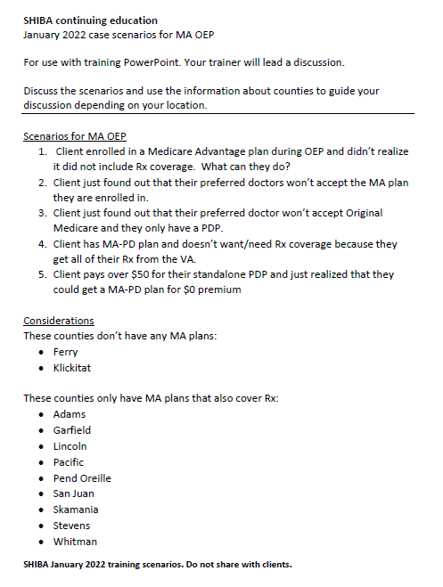
MA OEP topic information
Your RTC or VC will lead a role play demonstration on MA OEP topics.
You may use the scenarios on the document accessible from this slide, or go to the next slide for other suggestions.
https://www.insurance.wa.gov/media/10643
Continued
Notes:
SHIBA trainers
Let’s take some time to review some common scenarios that might come to you. Review the scenario document and consider your responses.
RTCs: As an option, you may save a copy of the scenario PDF (located on My SHIBA under January 2022 training) to your computer desktop and launch the document from that location.

Slide 6
MA OEP topic information (continued)
Other topic suggestions
MA OEP: What is it? Who is most impacted?
What choices are available?
How can you as an advisor help beneficiaries with making decisions?
Notes:
SHIBA trainers
Have the group work through 2-3 cases asking different volunteers to take lead on how they would work the case. Invite volunteers to ask questions about the cases that may be confusing, need clarification or require direction from the point of view of someone totally new to Medicare counseling.

Slide 7
SHIBA job aid: SHIBA counseling resources with links
Notes:
SHIBA Trainers
New SHIBA job aid: SHIBA counseling resources with links.
This job aid includes reminders, referral links, and especially the SEP link for delaying Part B and to the Extra Help/MSP brochure.
RTCs: Please share any feedback you receive on this new job aid with the SHIBA curriculum team.

Slide 8
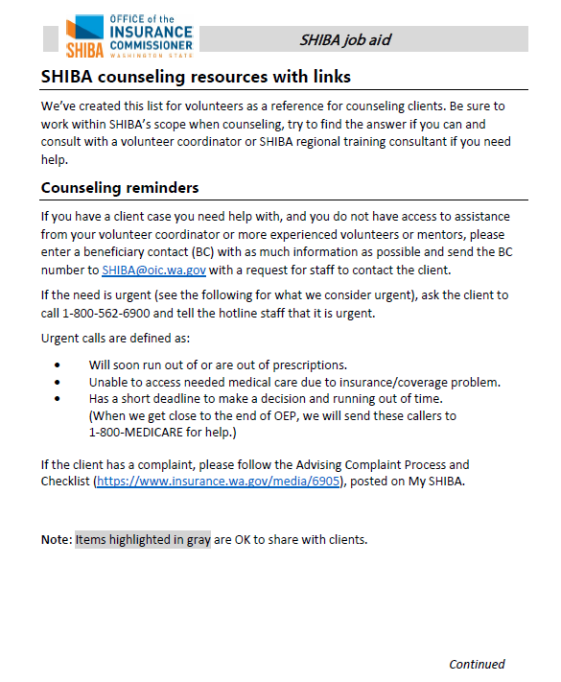
New SHIBA job aid: Resources with links
SHIBA counseling resources with links
This job aid is a reference to use when
counseling clients.
You may access the job aid from this link:
https://www.insurance.wa.gov/media/10642
Notes:
SHIBA trainers
Click the link to open it the job aid. Then use Ctrl F to search the document that opens.
RTCs: As an option, you may save a copy of the job aid to your computer desktop and launch the job aid from that location.
SHIBA counseling resources with links
We’ve created this list for volunteers as a reference for counseling clients. Be sure to work within SHIBA’s scope when counseling, try to find the answer if you can and consult with a volunteer coordinator or SHIBA regional training consultant if you need help.
Counseling reminders
If you have a client case you need help with, and you do not have access to assistance from your volunteer coordinator or more experienced volunteers or mentors, please enter a beneficiary contact (BC) with as much information as possible and send the BC number to SHIBA@oic.wa.gov with a request for staff to contact the client.
If the need is urgent (see the following for what we consider urgent), ask the client to call 1-800-562-6900 and tell the hotline staff that it is urgent.
Urgent calls are defined as:
• Will soon run out of or are out of prescriptions.
• Unable to access needed medical care due to insurance/coverage problem.
• Has a short deadline to make a decision and running out of time. (When we get close to the end of OEP, we will send these callers to 1-800-MEDICARE for help.)
If the client has a complaint, please follow the Advising Complaint Process and Checklist (https://www.insurance.wa.gov/media/6905), posted on My SHIBA.
Note: Items highlighted in gray are OK to share with clients.

Slide 9
Resources

Slide 10
2022 resources
Medicare & You 2022
Partner publication The 2022 version is now available online. https://www.medicare.gov/Pubs/pdf/ 10050-medicare-and-you.pdf
See the Notes for this slide and also the next PowerPoint slide for more
information on ordering this publication.
Notes:
Information about Medicare & You 2022
Information for ordering publications—including M&Y—through the Department of Enterprise Services (DES) is located on My SHIBA at https://www.insurance.wa.gov/order-shiba-publications.
From the DES Fulfillment site you can order the WA version of M&Y.
Note: Sponsor sites have been asked to order them for their locations, so volunteers may check with their volunteer coordinator for a copy of M&Y 2022.
CMS Medicare and You 2022 https://www.medicare.gov/Pubs/pdf/10050-medicare-and-you.pdf
Here is a link to an audio file and podcast information for ordering a copy of the national version of the handbook: https://downloads.cms.gov/media/medicare/pub/01-Welcome-to-Medicare-and-You-2021.mp3

Slide 11
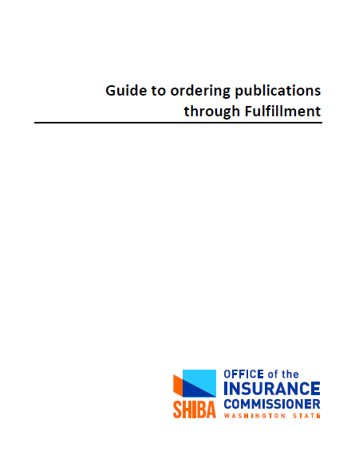
2022 resources (cont’d)
Guide to ordering publications through Fulfillment
Step-by-step instructions for ordering publications and have them directly mailed to you or a client.
SHIBA client publication
https://www.insurance.wa.gov/media/1562 10 pages
Notes:
Information for ordering publications through the Department of Enterprise Services (DES) Fulfillment is located on My SHIBA at https://www.insurance.wa.gov/order-shiba-publications.

Slide 12
2022 resources
2022 Medicare Part A and B chart is now posted on these pages:
https://www.insurance.wa.gov/how-much-do-medicare-parts-and-b-cost
https://www.insurance.wa.gov/what-medicare-part-hospital-insurance-covers
https://www.insurance.wa.gov/what-medicare-part-b-medical-insurance-covers
https://www.insurance.wa.gov/shiba-publications
The chart is also available:
Online at https://www.insurance.wa.gov/media/10536
For ordering through Fulfillment (see slide 11).

Slide 13
2021-2022 training schedule
2022 Topics
February: SHIBA’s Top 10 counseling questions
March: Extra Help and MSP
April: Volunteer recognition
May – December: To be announced
Topics are subject to change.

Slide 14
Evaluation
Your responses help to improve SHIBA’s training program.
Did you find today’s training helpful or useful for your SHIBA counseling or outreach?
What would have made this training better for you?
Please take some time to send thoughts to shiba@oic.wa.gov or to your trainer.
Or you may use our brief online survey at https://www.surveymonkey.com/r/SHIBA-TrainingEvaluation.
We appreciate your feedback!

Slide 15
Photo credits
Slide 1
Slide 2
Photo by Kelly Sikkema on Unsplash
Slide 13
Photo by Eyestetix Studio on Unsplash
Photo by Vladimir Soares on Unsplash | Photo by Visual Stories || Micheile on Unsplash | Photo by Jixiao Huang on Unsplash
Photo by Nathan Anderson on Unsplash |  | Photo by Ekaterina Shakharova on Unsplash

