Slide 1
Joy Erven, MBA
CEO & Executive Director
Surplus Line Association of Washington

Slide 2
ADMITTED VS. NON-ADMITTED
Admitted
Regulated by the State
Guaranty Fund
Filed Rates and Forms
Used by Property and Casualty Producers
Non-Admitted
Not Regulated by State (Subject to State Oversight)
No Guaranty Fund
Freedom of Rate and Form
Needs a Special License to Access

Slide 4
SURPLUS LINE PRODUCTS
The surplus line market plays an essential role in developing new or unusual coverage that the admitted market cannot provide.
The surplus line insurers have specialized expertise in underwriting surplus lines products.
Surplus line employees must acquire and maintain expertise in handling a wide range of products.

Slide 5
ROLES AND RELATIONSHIPS BETWEEN RETAILER, WHOLESALER, AND SURPLUS LINE INSURER

Slide 6
FLOW OF BUSINESS FROM INSURED TO
NON-ADMITTED INSURER
Insured
Retail
Agent
Wholesaler
Non-Admitted Insurer

Slide 7
WHAT IS THE SLA OF WASHINGTON?
Private Non-Profit 501(C)6 Organization formed in 1944
Members are Surplus Line Brokers licensed in the state of Washington
Statutory Surplus Line Advisory Organization to the OIC
Governed by a Board of Directors elected by the membership

Slide 8
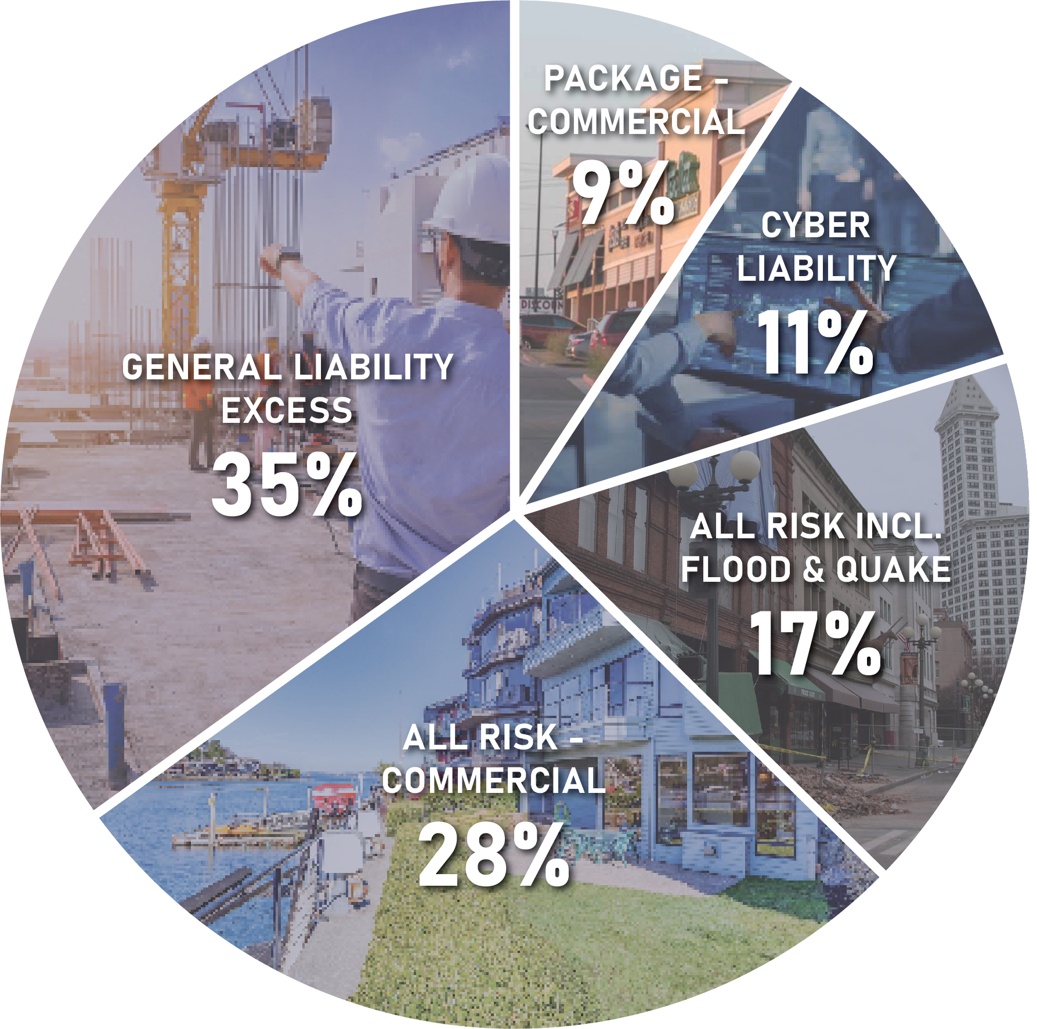
ROLE OF THE SLA
Receive, Record and Review Documents
Data Collected is Source of Reports to OIC and SLA Membership to Monitor Surplus Line Activity in Washington
Premium Reporting to the OIC for Annual State Tax Statements
Educate Members in Understanding of Washington Surplus Lines
Laws & Regulations
One on One Training
Seminars
Continuing Education
Newsletters and Bulletins
Work with Members and OIC to Maintain a Healthy Marketplace in Washington
*Top 5 Coverages
2023 Annual Report

Slide 9
THE RELATIONSHIP BETWEEN THE OIC AND SLA
Collaborative Partnership!
Liaison between Surplus Line Brokers and OIC
Annual Tax Statement Communication and Facilitation
Premium and Coverage Reporting
Participation in Working Groups
Communication Between OIC and Surplus Line Brokers
Facilitate Broker Compliance with Regulations
Implementation of Programs and Systems on a State & National Level
Provide Education to Licensees

Slide 10
MISSION STATEMENT
Promote a stable non-Admitted insurance market in the State of Washington to offer viable options to the insurance buying public.
Encourage and facilitate compliance by its members with the laws of the State of Washington and of the United States of America relative to surplus line insurance coverage, and with the laws, rules, and regulations of the Office of the Insurance Commissioner of the State of Washington.
Provide means for the examination of surplus line policies placed by members on Washington risks in accordance with Rules as established by the Association, and as may be amended from time to time, and provide assistance, as appropriate, to members in filing and compliance.
Supply educational support to the members of the Association including dissemination of information regarding laws, rules and regulations relevant to surplus lines insurance. Support insurance education relative to surplus lines insurance in the State of Washington through sponsorship of training classes and seminars, or grants of money or expertise to educational institutions.
Communicate with the Legislature and Office of the Insurance Commissioner in support of our members and the Non-Admitted Marketplace.

