Slide 1
Getting ready for Medicare Open Enrollment and using Plan Finder
September 2020 continuing education
Created August 12, 2020

Slide 2
Today’s agenda
Learning objectives
Troubleshooting and sharing time
Getting ready for Medicare Open Enrollment
Counseling logistics for OEP during COVID-19
Optional: Mechanics of Plan Finder practice sessions
Effective communication with clients
Job aids to support you during OEP
Resources
2020-21 continuing education topics
Continuing education evaluation
Notes:
Ideas:
Introduction, timeline, job aids, plan finder, enrollment, and/or letters.
Getting ready for Medicare Open Enrollment: Placeholder for VCs to have 15- 30 minutes to share and plan in their area.
Mechanics of Plan Finder: Optional or watch other webinars. RTCs to decide how to approach this in their area depending on needs.

Slide 3
Learning objectives
After completing this training, you should be able to:
Demonstrate using Plan Finder and share results with beneficiaries through email.
Describe at least two specific options to convey Plan Finder results to the client. Describe your plan to touch base with them, as needed, to finalize their choice in their enrollment.
Explain how the enrollment has been completed online and what to say to the client about what to expect.
Notes:
Trainers:
Plan Finder is optional to use for September continuing education (CE).
Other options:
Watch recorded CMS NTP workshop held on August 12, 2020, and/or share SHIP TA Center document posted July 2020 that describes planned updates to Plan Finder from mid-July to mid-October 2020.
Also, watch SHIP TA Center and CMS for updated tools, webinars or YouTube videos.
Demonstrate using Plan Finder.
Help volunteers feel comfortable with using Plan Finder and sharing results with beneficiaries via email.
Learning objectives:
Counselor/learner will describe at least two specific options to convey Plan Finder results to the client and have a plan to touch base with them to finalize their choice in their enrollment.
Good practice to: talk to client, run Plan Finder, run results, review, make an appointment to revisit description, then complete enrollment. This goes through the process and completes the loop. Helps with follow through. Can help with Beneficiary Contacts (BCs). Try and complete the process within a week. Set up second appointment with client while on the phone with them for the follow up. Is your agency or group doing this?
Show how to do BCs. Some sponsors have a system for how to track these.
Be able to complete a (personal) Plan Finder analysis for a client with confidence.
Some groups don’t do these. Maybe be able to do the alternative for a general search. Be familiar with both.
Will get the best results if personalized but sometimes counselor can only do a general search.
Counselors should be able to describe or role model explaining how they’re going to get the results to the beneficiary (email, phone) and describe follow-up plan to complete the process. May be a second phone call to help complete the process.
Counselor will model how they will explain how the enrollment has been completed online and explain to the client what to expect.
Ideas for trainers
What do you want to cover to achieve the learning objectives?
Ideas: Introduction, timeline, job aids, plan finder, enrollment, letters
Outline
Logistics in the time of COVID, logistics during OE during the pandemic. Hybrid
models. Online and small groups.
Mechanics of Plan Finder. Using. Playing with it. Practice. How to maximize your
time on PF.
Effectively communicating with clients to complete enrollment.
Job aids to support you during OE.
Practice how to communicate and let consumers know what you are going to do.
Maybe breakout rooms to practice.
Maybe develop short scripts as examples.
Check with Judith for templated letter examples. Some may already have their own scripts to share.

Slide 4
Troubleshooting and sharing
Review July topics
  Original Medicare and Medicare Supplement (Medigap) Insurance
Review publications from July training
  Medicare & You
  What you need to know about Medigap (Medicare Supplement plans
  Approved Medicare Supplement (Medigap) plans
Local topic sharing
Other topics

Slide 5
Getting ready for Medicare Open Enrollment
Notes:
Trainers and Volunteer Coordinators:
This section is a placeholder for VCs to have 15- 30 minutes to share and plan in their area.

Slide 6
Medicare OEP help
Your trainer will lead a discussion on what online tools and references are available to volunteers for Open Enrollment.
More materials will become available as we get closer to OEP. Keep an eye out for these materials from our reliable partner sources.
CMS www.cms.gov/
SMP www.smpresource.org/
SHIP TA www.shiptacenter.org/
ACL acl.gov/
WA HealthPlanFinder www.wahealthplanfinder.org
Others?
Notes:
Trainers:
We definitely know there will be some webinars that have been recorded by the time OEP begins.
We will need to discuss how to use these materials -- either watch together at your CE session, or have volunteers review on their own time as needed and depending on when the materials become available.
August and September would be a good month for practicing plan finder. This could be a good time for volunteers to do some research.
Trainers could consider doing a separate Zoom training on using plan finder. Separate from CE training.
Outline planning thoughts:
Getting ready for Medicare Open Enrollment
This is usually when we talk about timeline. Share the document with the color coded letters. Guide to mailings. Refer to this in a different way possibly. Annual notice of change. Dates during which the annual notice of change comes. And dates for M&Y, and also letters. The colored letters have our 800 number on it.
Notice of change.
Grey letter about extra help.
Counselors should tell clients to open any letter that is coming from a plan they currently belong to. Even if it looks like junk. Open to review. There may be important dates or plan information or formulary information.
Talk about how VCs will handle picking up messages and the logistics of scheduling OE. Some of this may need to be pushed to October such as information about plans.
Mention how CMS and the feds and some organizations call OEP by the term AEP Annual Enrollment Period.
Look at the job aids.
Look for existing sources from trusted sources to use or adapt.
YouTube videos. CMS about doing a plan finder analysis. Need reliable content. Maybe find in early August. See if we can find something nuts to bolts of less than five minutes. We’re keeping an eye out. Plan finder is a bit different now.
YouTube: Can we find info about Plan Finder changes
https://www.youtube.com/watch?v=eZYO61st9eQ
SHIP National Training Program: Will there be anything new and/or different to share? Lots of webinars for OEP. Encourage volunteers and VCs to sign up to round out their education.
Refer to things that we know are coming up that will be new. For example: plans will be offering insulin at a low price (could be news flash info). Examples. Reminder we won’t know what plans will offer until the beginning of October, so September training is a reminder to follow up in October. Help share important info as soon as its needed. CE or News Flash info could be on the way.

Slide 7
Medicare OEP planning
Trainers and volunteer coordinators will lead a discussion on Open Enrollment planning.
What considerations are there for your region?
What questions or problems do you anticipate?
How can you best prepare for Open Enrollment during a pandemic?
Notes:
Trainers:
OEP training may be adapted to fit the needs of your group.
This will be your time to talk with your groups about OEP planning, particularly since we recently held the VC conference and OE took a front seat for planning and discussion.

Slide 8
Changes planned for 2021
Discussion activity
Spend some time discussing changes we know are planned for 2021.
We may not know a lot at the time of publishing this training, so keep a close eye on trusted sources and working with your VC and RTC.

Slide 9
People with ESRD
Starting January 1, 2021, beneficiaries with ESRD will be able to enroll in any Medicare Advantage (MA) plan in their area.
They will need to review coverage details, participating providers and costs carefully.

Slide 10
Part D Senior Savings Model
Insulin prices are capped by some plans in 2021:
Allowed by Enhanced plans, both PDP or MAPD
  Enhanced plans probably have higher premiums, offsetting cost-savings.
Participating plans cap co-pays for insulin at $35
  Capped co-pays only for insulin on plan’s formulary.
Plan Finder should help evaluate actual savings for clients.
See Kaiser Family Foundation (KFF) article: Insulin Costs and Coverage in Medicare Part D.
www.kff.org/medicare/issue-brief/insulin-costs-and-coverage-in-medicare-part-d/
Notes:
Not Basic plans and not for people with LIS, who should already pay less.
Cap is at all coverage phases (deductible, initial coverage, coverage gap and catastrophic).

Slide 11
Changes to D-SNP plans
Washington state Health Care Authority to contract with MA-PD plans for dual-eligible Medicare and Medicaid enrollees (also known as D-SNP plans).
Goal is to help align Medicare and Medicaid coverage.
Not all counties will have plans.
May be some D-SNP plans leaving at the end of 2020.
Clients will need to review coverage details, participating providers and Rx coverage carefully.
More information will be shared when available.

Slide 12
Counseling for OEP and COVID-19

Slide 13

COVID-19: You can protect yourself
Avoid COVID-19 scams.
Have you received robocalls, text messages or emails offering free face masks? Or maybe you've seen social media posts about free COVID-19 testing kits, "cures," or protective equipment?
Unfortunately scammers are using the COVID-19 pandemic to try and steal your Medicare number and personal information. If anyone reaches out to get your Medicare number or personal information in exchange for something, you can bet it's a scam.
Continued

Slide 14

COVID-19: You can protect yourself (cont’d)
Prevent Medicare Fraud.
Stop scams before they happen.
Watch this short video and visit Medicare.gov/fraud for tips on preventing Medicare scams and fraud. If you suspect fraud, call
1-800-MEDICARE to report it.

Slide 15

Medicare & You
  What are my rights if my plan
  stops participating in Medicare?
  M&Y page 90
Medicare health and prescription drug plans can decide not to participate in Medicare for the coming year. In these cases, client coverage under the plan will end after December 31. If this happens, their plan will send them a letter explaining their options.
A client can choose another plan October 15 through December 7. Their coverage will start January 1.
Continued

Slide 16
Medicare & You (continued)
Clients will have a special right to join another Medicare plan until February 28, 2021.
They may have the right to buy certain Medigap policies within 63 days after their plan coverage ends.

Slide 17
Discussion
Your volunteer coordinator and/or trainer will lead a discussion on the logistics of counseling and volunteering during COVID, with a focus on OEP.
Notes:
Trainers:
Counseling logistics during COVID-19 with a focus on OEP.
Consider hybrid models for discussion and training. For example: Online and small groups with knowledge checks and Q&A options.
This is where we can ask the VCs, who have recently been to the VC conference, to work with their groups about planning and logistics

Slide 18
Optional: Mechanics of Plan Finder
Practice sessions
Notes:
Trainers:
This section is optional. You may use this section or other topic-related webinars. You’ll decide how to approach this in your area depending on needs.

Slide 19
What’s your experience?
  Q1: What is the purpose of Plan Finder?
  Q2: What are the problems that you or your clients have encountered?

Slide 20
Plan Finder updates
As previously shared, the CMS team has implemented updates to the Medicare Plan Finder periodically since the start of 2020.
Changing the default sort to yearly drug cost plus premium cost
Redesigning the plan information to improve readability
Implementing a variety of visual enhancements
Increasing the frequency of data updates.
  Continued

Slide 21
Plan Finder updates (continued)
Mid July
Upgrades to streamline the login process and improve the experience as beneficiaries navigate between the MyMedicare features and Plan Finder features.
  Updating the Plan Finder landing page to move calls to action higher on the page and reduce the need to scroll.
  Continued

Slide 22
Plan Finder updates (continued)
August
Work to prepare for Open Enrollment launch. Updates to the display of plan details will be made so plans can accurately preview their 2021 plan data, but won’t be visible yet on the public Plan Finder site. Plans will then preview to verify that their information is displaying accurately prior to Open Enrollment.
Continued

Slide 23
Plan Finder updates (continued)
September
Updates to Pharmacy Selection Options include the ability to:
Find pharmacies based on the name of the pharmacy.
Add up to 4 pharmacies and mail order.
  Change pharmacies from the plan details page more seamlessly.
  For example, if a beneficiary selected 4 pharmacies and none of them were in network and/or preferred, they could “substitute” to select different pharmacies in their area.
Continued

Slide 24
Plan Finder updates (continued)
Early October
Adding Drug frequency options
  Allows beneficiaries to select 1 or 2x a year fills and smaller usage dosages to see more precise cost information.
Updates to search results filter
  Adding Medicare Advantage Plan Type filter (i.e., PPO, HMO, etc.) to allow users to narrow down the search results to the types of plans they are looking for.
  Adding drug coverage filter to allow users to only see plans that cover all their drugs.
Continued

Slide 25
Plan Finder updates (continued)
New: Beneficiaries will see future LIS pricing when logged into My Medicare account (“personalized search”)
  Anonymous search will only show prices based upon information that was entered at the beginning of the search.
New: Renal dialysis benefit information will display in plan benefits (important to ESRD beneficiaries who are becoming eligible for Medicare Advantage).
New: Flag will designate plans participating in the Part D Senior Savings Model.
Continued

Slide 26
Plan Finder updates (continued)
October 1: 2021 plan options will be visible
October 15: Enroll now button will go live for 2021 plan options

Slide 27

Group activity: Mechanics of Plan Finder
www.medicare.gov/plan-compare/#/?lang=en
Your trainer may present Plan Finder.
Review functionality as a group
Practice using it
Discuss with your group how to maximize your time on Plan Finder
Discuss functionality and any questions you have
Notes:
Trainers:
Optional: Discuss as a group or use the Zoom breakout room option to discuss in smaller groups.
Mechanics of Plan Finder: Using, playing with it, practice, and how to maximize your
time on Plan Finder.
Mechanics of Plan Finder
Practicing Plan Finder.
Perhaps develop a Zoom recording.

Slide 28
Optional practice sessions:
Effectively communicating with clients to complete enrollment
Notes:
Trainers:
This section is optional.

Slide 29
Effective communication
Practice how to communicate and let clients know what you are going to do.
Maybe breakout rooms to practice.
Maybe develop short scripts as examples.
Does your agency have templated letter examples?
Some agencies may already have their own scripts to share.
Notes:
Trainers:
Practice how to communicate and let consumers know what you are going to do.
Maybe breakout rooms to practice.
Maybe develop short scripts as examples.
Templated letter examples. Some agencies may already have their own scripts to share.. This could help discover what is correct or not.
Practice Sessions: Effectively communicating with clients to complete enrollment
Do you work from a script?
Trainers may check with the SHIBA field supervisor for examples if interested.
Scripted items to cover include:
Here is your confirmation number, we will email it, it’s important.
Here are next steps.
You will receive welcome packet .
Look in the mail for things that say “well care” or “Aetna.” Might look like junk but there will be info like formulary, websites, info, member id…don’t throw this stuff away. It might be needed in the future.
In late September call your favorite pharmacy to verify info so there is no delay for meds.
Looked for canned follow-up letter. (Trainers: The SHIBA field supervisor has examples for letters and scripts if interested).

Slide 30
Job aids to support you during OEP
Notes:
Trainer ideas:
Job aids to support you during OEP.
Get help paying/Extra Help job aid. And the Medicare savings program info.
https://www.insurance.wa.gov/sites/default/files/documents/get-help-pay-for-medicare-brochure_2.pdf
https://www.insurance.wa.gov/sites/default/files/documents/medicare-savings-programs-application-desk-aid.pdf
Uploaded enrollment into STARS – process job aid.
Timeline.
Document with the color-coded letters.
Extra help LIS copay levels job aid SHIBA version.
Job aid with LIS levels. Extra help LIS copay levels job aid SHIBA version. 2020 version but would help to have the 2021 copay levels. Liz has a shorter version that could work. Could share a slightly less detailed version to help people figure out their copays for 2021. Posted on My SHIBA.
Would be great if uploaded enrollment into STARS. Or just the confirmation number into the notes field. If save electronic version of enrollment as PDF it can be uploaded to STARS and attached to the BC –becomes a point of reference. Maybe build a small process as a job aid. Include name of plan and date. Do a better job of documenting to help with tracking if needed for future reference.

Slide 31

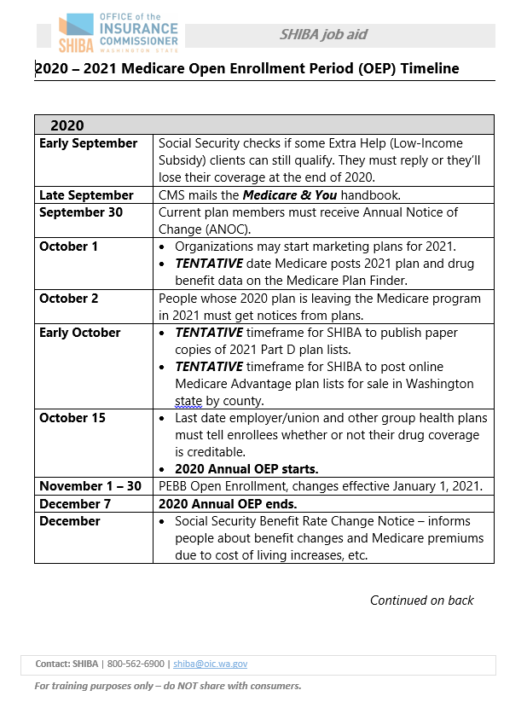
September 2020 learning aids
Medicare & You 2020
Partner publication
Note: this is the national 2020 version.
The 2021 version may be available online mid-September.
www.medicare.gov/Pubs/pdf/10050-medicare-and-you.pdf
2020-2021 Medicare Open Enrollment Period (OEP) timeline
SHIBA job aid
www.insurance.wa.gov/sites/default/files/documents/medicare-oep-timeline_2.pdf
2 pages
Notes:
Notes for job aids:
SHIBA Job Aid: SHIBA and PEBB: Counseling roles.
SHIBA client publication SHP838: Medicare Plan comparison form.
SHIBA client publication SHP 855: Your SHIBA Medicare Action plan (provides help with Open Enrollment). www.insurance.wa.gov/sites/default/files/documents/shiba-medicare-action-plan.pdfdicare-action-plan-Rev.8-16
Helps with determining next steps and referrals.
SHIBA client publication (online only): Medicare PlanFinder worksheet .www.insurance.wa.gov/sites/default/files/2019-08/medicare-planfinder-worksheet.pdf
Job Aid: Medicare PlanFindermedicare.gov.
SHIBA client publication SHP870: New Medigap changes take place in 2020.
Job Aids: August 2019 Medicare Minute: Medigaps, login required shiptacenter.org.
CMS Module 03: Supplemental Insurance (Medigaps), Login required, see P. 33 of this packet for more information.
SHIBA Job Aid: SHIBA’s Confidentiality requirements.

Slide 32

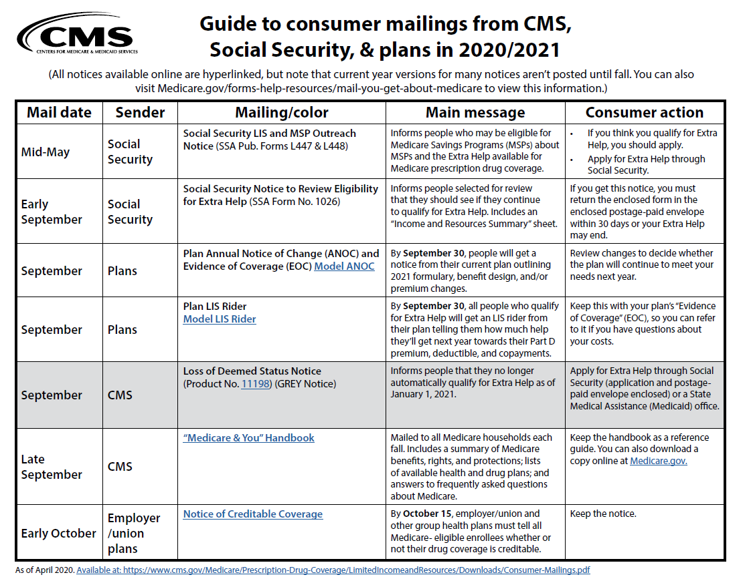
September 2020 learning aids
Medicare Minute: Medicare Open Enrollment Period
Partner publications
Script, handout and teaching materials.
www.shiptacenter.org
Search the Resource Library for Medicare Minute.
CMS Guide to consumer mailings
Partner publication
www.cms.gov/Medicare/Prescription-Drug-Coverage/LimitedIncomeandResources/Downloads/Consumer-Mailings.pdf
Five pages

Slide 33
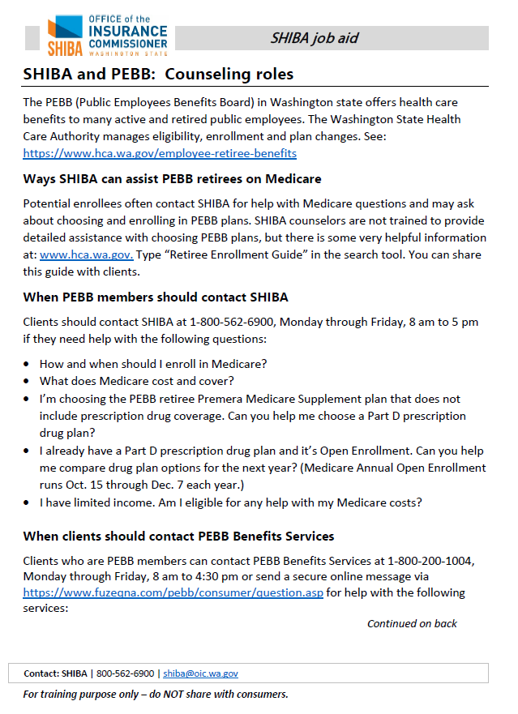
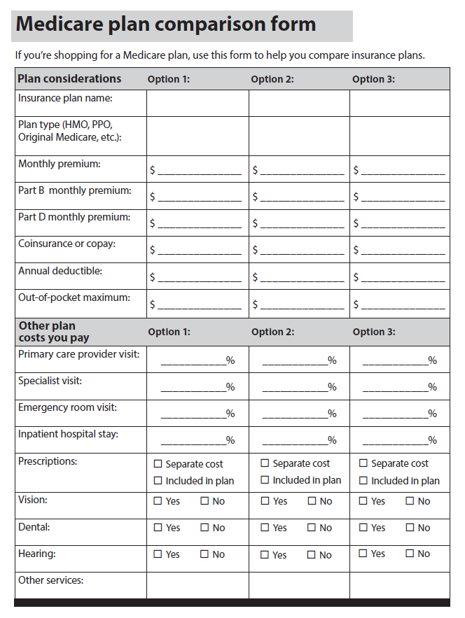
September 2020 learning aids
SHIBA and PEBB: Counseling roles
SHIBA job aid
www.insurance.wa.gov/sites/default/files/documents/shiba-pebb.pdf
Two pages
Medicare plan comparison form (SHP838)
SHIBA client publication
www.insurance.wa.gov/sites/default/files/documents/medicare-plan-comparison-form_2.pdf
Two pages

Slide 34
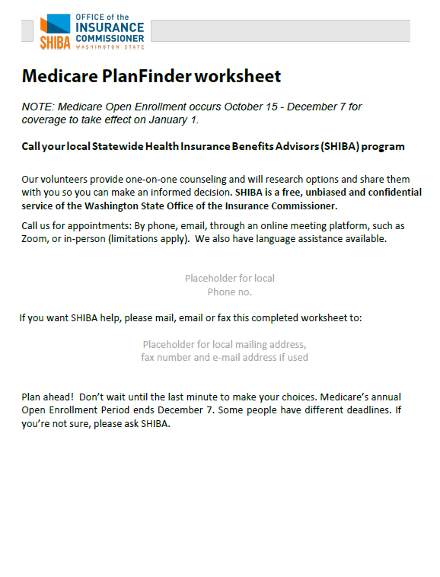
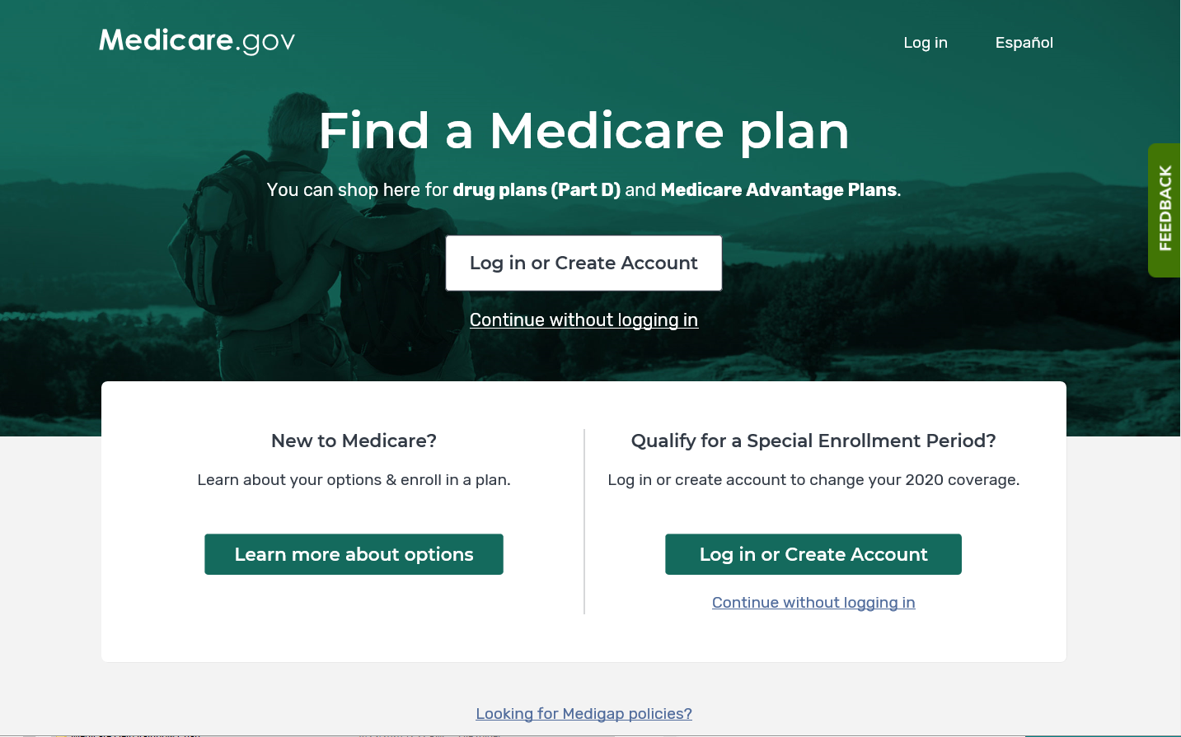
September 2020 learning aids
Medicare Plan Finder worksheet
SHIBA client publication
Search My SHIBA for “planfinder worksheet”
www.insurance.wa.gov/media/8042
Four pages
Medicare Plan Finder: Find a Medicare plan
Partner website
www.medicare.gov/plan-compare

Slide 35
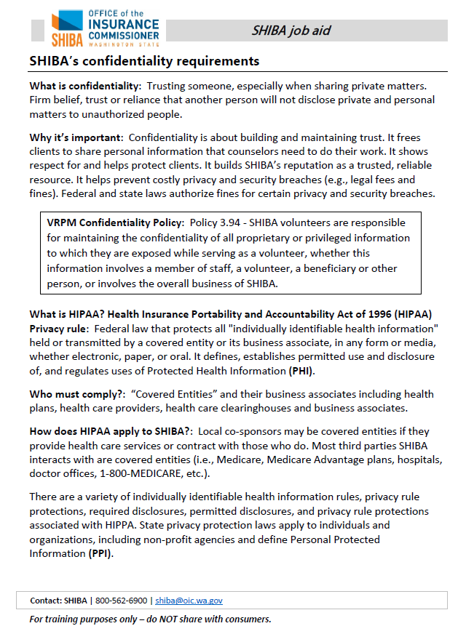
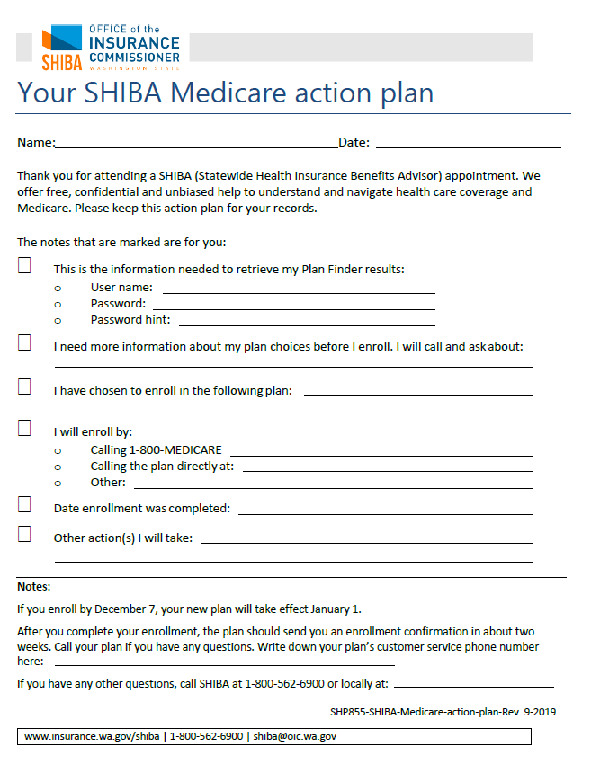
September 2020 learning aids
SHIBA’s confidentiality requirements
SHIBA job aid www.insurance.wa.gov/sites/default/files/documents/shiba-confidentiality-requirements.pdf
Three pages
Your SHIBA Medicare action plan (SHP 855)
SHIBA client publication
www.insurance.wa.gov/sites/default/files/documents/shiba-medicare-action-plan_0.pdf
One page

Slide 36
CE topics and evaluation

Slide 37
2020 continuing education topics
Month | Topic | Medicare & You
October | Medicare Part D and Medicare Advantage | Section 6
November | No training
December | No training
2021
January | A look at what’s new for 2021 and a broad overview of M&Y 2021 | All sections
February | SHIP TA Center Level 3 Appeals & Penalties | Section 8
March | SHIP TA Center Level 4 Course 1 & 2. Medicare & Employer coverage; Medicare & Other insurances. | 1
April | Volunteer recognition! Special Topic: Hospital discharge. | N/A
Notes:
This is what we have planned for 2020 and 2021.
Topics are subject to change.

Slide 38
Evaluation
Please take some time to send thoughts to shiba@oic.wa.gov, dianas@oic.wa.gov or to your trainer.
We appreciate your feedback!

