Slide 1
Getting ready for Medicare Open Enrollment and using Plan Finder
September 2021 continuing education
Updated September 9, 2021
Notes:
Updates to this version
Slides 10-15: Updated to 2021/2022 version of the Guide to consumer mailings from CMS.
Slide 24: Deleted a duplicate web link.
Slide 43: Updates picture for the 2022 version of Medicare & You.

Slide 2
Agenda
Learning objectives: You should you be able to complete Open Enrollment and Plan Finder training goals after today’s continuing education.
What’s new?
Sharing time
Open Enrollment overview
Plan Finder
Wrap-up
Notes:
SHIBA trainers
Here are some training ideas:
Introduction, timeline, job aids, plan finder, enrollment, and/or letters.
Getting ready for Medicare Open Enrollment: Placeholder for VCs to have 15-30 minutes to share and plan in their area.
Mechanics of Plan Finder: Optional or watch other webinars. RTCs to decide how to approach this in their area depending on needs.

Slide 3
Learning objectives: OEP overview
Explain the major events and timing of Open Enrollment starting in September 2021.
If information is available, learn about any changes for 2022.
Explain what choices clients can make during Open Enrollment.
Explain enrollment periods that happen from September through March and how they apply to a client’s situation.
Define steps to cover when counseling clients about Open Enrollment options.
Share SHIBA role with PEBB and other retiree plan assistance.
Notes:
SHIBA trainers
Links on the slide:
“Major events and timing” links to: Guide to consumer mailings from CMS, Social Security, & plans in 2020/2021 https://www.cms.gov/Medicare/Prescription-Drug-Coverage/LimitedIncomeandResources/Downloads/Consumer-Mailings.pdf
“Starting in September 2021” links to: 2021 – 2022 Medicare Open Enrollment Period (OEP) timeline https://www.insurance.wa.gov/sites/default/files/documents/medicare-oep-timeline_3.pdf

Slide 4
Learning objectives: Plan Finder
Perform a personalized or general search of Medicare Part D and Part C plans for clients.
Identify a client’s current coverage using the Plan Finder tool.
Enter a client’s drugs into the Plan Finder tool.
Identify the top plan options for clients based on cost and benefits.
Identify pertinent health insurance information from the Plan Finder tool.
Explain a client’s health insurance options, costs and benefits using Plan Finder printouts.
Share printout information electronically, in person or by US mail.
Notes:
SHIBA trainers
Links on the slide:
“Personalized” links to: Setting up a Medicare Plan Finder online user account https://www.insurance.wa.gov/sites/default/files/documents/plan-finder-account-creation.pdf
“Current” links to: Setting up a Medicare Plan Finder online user account https://www.insurance.wa.gov/sites/default/files/documents/plan-finder-account-creation.pdf
“Enter a client’s drugs” links to: Medicare PlanFinder worksheet https://www.insurance.wa.gov/sites/default/files/documents/medicare-planfinder-worksheet.pdf

Slide 5
What would you like to share? (15 minutes)
VC may share any updates.
Volunteers are welcome to share anything!
Photo by CJ Dayrit
SHIBA advisor continuing education | September 2021
Notes:
SHIBA trainers
This time is for your VC or sponsor to share relevant updates with the group.
It also gives volunteers time to ask questions of the VC or request needed materials.
Remind volunteers this is NOT the time to share or ask for help with client cases. Time for asking for help with client cases may be shared at the end of CE.

Slide 6
Open Enrollment overview

Slide 7
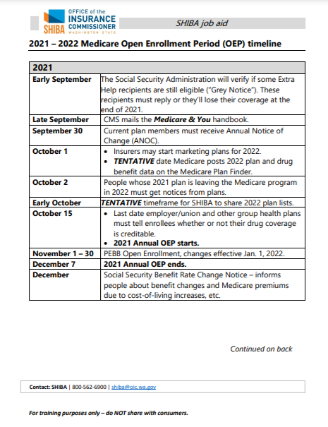
Job aid: Medicare OEP timeline
2021-2022 Medicare Open Enrollment Period timeline
Provides OE timeline planning for Sept. 2021 through March 2022.
A larger version is on the next two slides.
The full version is on My SHIBA.
Two pages.
https://www.insurance.wa.gov/media/6901
Notes:
SHIBA trainers
Take a little time to review the job aid, discuss and answer any questions if needed.
The 2021-2022 Medicare Open Enrollment Period timeline document may be found by doing search on My SHIBA for “Medicare open enrollment period timeline”.
You may either link to the My SHIBA version of the document or use the versions on the next two slides for reference in case you are unable to access the My SHIBA site.

Slide 8
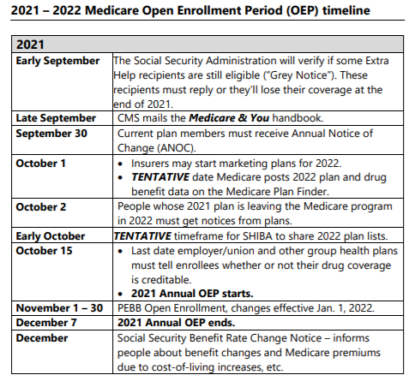
2021-22 Medicare OEP timeline
Page 1 of 2
https://www.insurance.wa.gov/media/6901
Notes:
2021-2022 Medicare Open Enrollment Period timeline
Page 1 of 2
https://www.insurance.wa.gov/media/6901

Slide 9
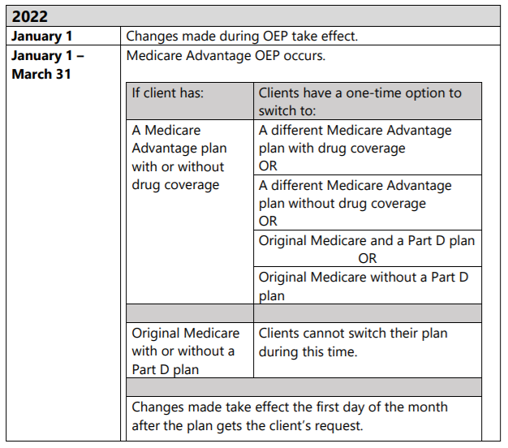
2021-22 Medicare OEP timeline
Page 2 of 2
https://www.insurance.wa.gov/media/6901
Notes:
2021-2022 Medicare Open Enrollment Period timeline
Page 2 of 2
https://www.insurance.wa.gov/media/6901

Slide 10
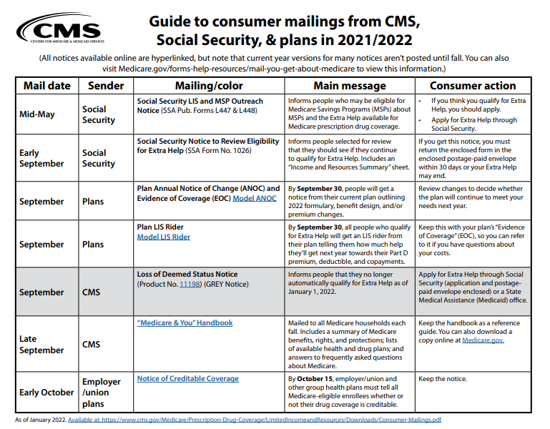
Job aid: Guide to mailings
Guide to consumer mailings from CMS, Social Security & plans in 2021/2022
Also known by SHIBA as “the guide to colorful letters.”
See full version on the next five slides and also on CMS.gov.
Five pages.
https://www.cms.gov/Medicare/Prescription-Drug-Coverage/LimitedIncomeandResources/Downloads/Consumer-Mailings.pdf
Notes:
SHIBA trainers
This will be your time to talk with your groups about OEP planning. OEP training may be adapted to fit the needs of your group.
The CMS Guide to consumer mailings document may be found by doing a web search (such as Google or Bing) for “cms guide to consumer mailings” or by visiting CMS.gov and searching for the same phrase.
You may either link to the CMS.gov version of the document or use the versions on the next five slides for reference in case you are unable to access the CMS site.

Slide 11
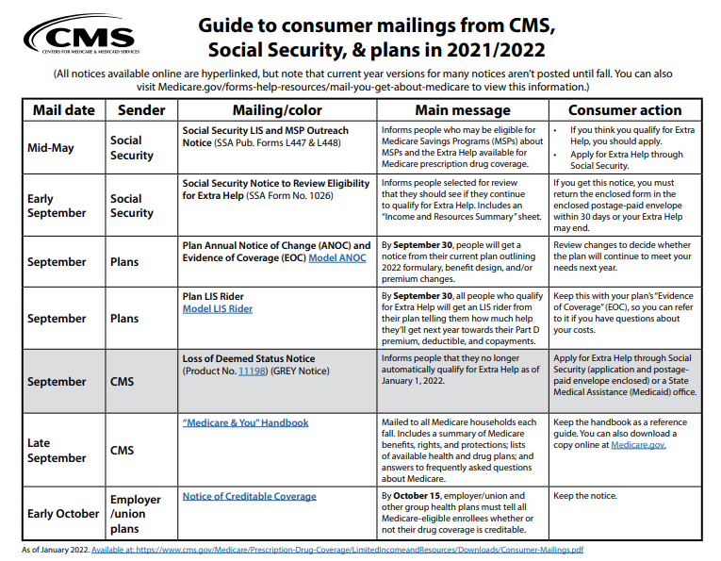
Page 1 of 5
https://www.cms.gov/Medicare/Prescription-Drug-Coverage/LimitedIncomeandResources/Downloads/Consumer-Mailings.pdf
Notes:
Guide to consumer mailings from CMS, Social Security, & plans in 2021/2022
Page 1 of 5
https://www.cms.gov/Medicare/Prescription-Drug-Coverage/LimitedIncomeandResources/Downloads/Consumer-Mailings.pdf

Slide 12
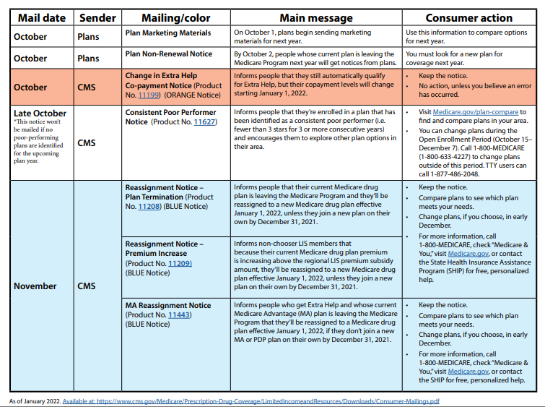
Page 2 of 5
https://www.cms.gov/Medicare/Prescription-Drug-Coverage/LimitedIncomeandResources/Downloads/Consumer-Mailings.pdf
Notes:
Guide to consumer mailings from CMS, Social Security, & plans in 2021/2022
Page 2 of 5
https://www.cms.gov/Medicare/Prescription-Drug-Coverage/LimitedIncomeandResources/Downloads/Consumer-Mailings.pdf

Slide 13
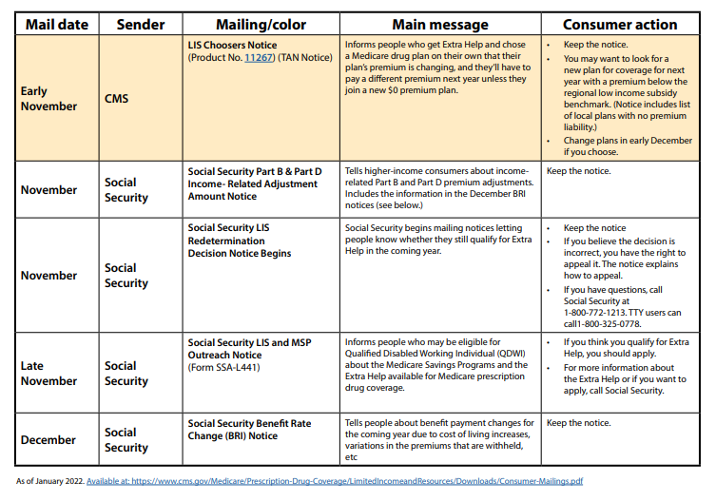
Page 3 of 5
https://www.cms.gov/Medicare/Prescription-Drug-Coverage/LimitedIncomeandResources/Downloads/Consumer-Mailings.pdf
Notes:
Guide to consumer mailings from CMS, Social Security, & plans in 2021/2022
Page 3 of 5
https://www.cms.gov/Medicare/Prescription-Drug-Coverage/LimitedIncomeandResources/Downloads/Consumer-Mailings.pdf

Slide 14
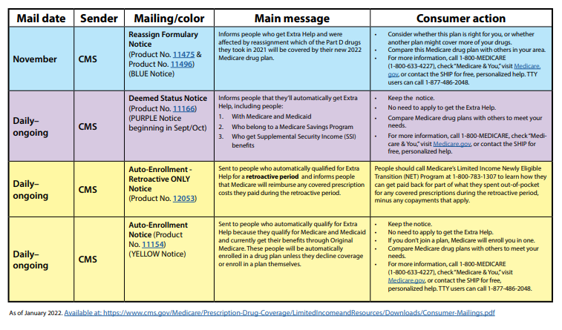
Page 4 of 5
https://www.cms.gov/Medicare/Prescription-Drug-Coverage/LimitedIncomeandResources/Downloads/Consumer-Mailings.pdf
Notes:
Guide to consumer mailings from CMS, Social Security, & plans in 2021/2022
Page 4 of 5
https://www.cms.gov/Medicare/Prescription-Drug-Coverage/LimitedIncomeandResources/Downloads/Consumer-Mailings.pdf

Slide 15
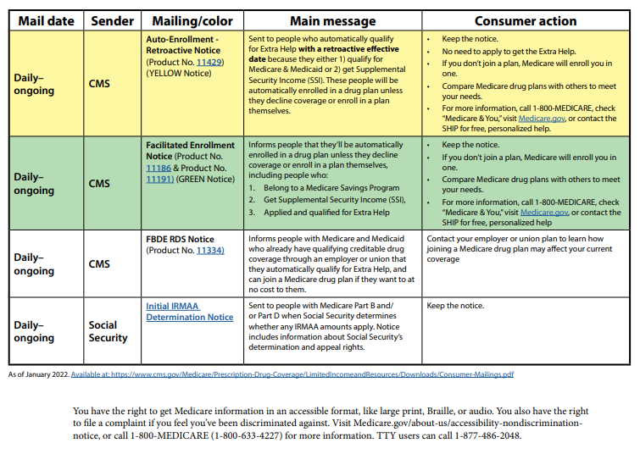
Page 5 of 5
https://www.cms.gov/Medicare/Prescription-Drug-Coverage/LimitedIncomeandResources/Downloads/Consumer-Mailings.pdf
Notes:
Guide to consumer mailings from CMS, Social Security, & plans in 2021/2022
Page 5 of 5
https://www.cms.gov/Medicare/Prescription-Drug-Coverage/LimitedIncomeandResources/Downloads/Consumer-Mailings.pdf

Slide 16
Medicare.gov document accessibility
People on Medicare have the right to get Medicare information in an accessible format, like large print, Braille, or audio. They also have the right to file a complaint if they feel they’ve been discriminated against.
Visit Medicare.gov/about-us/accessibility-nondiscriminationnotice, or call 1-800-MEDICARE
(1-800-633-4227) for more information. TTY users can call 1-877-486-2048.
Notes:
SHIBA trainers
This information is being provided as a reminder that SHIBA and our partners work in a variety of ways to provide accessible content in various formats. If there are questions, they may contact shiba@oic.wa.gov or the partner, such as Medicare.gov on this slide, directly.
https://www.medicare.gov/about-us/accessibility-nondiscrimination-notice

Slide 17
Scenarios: Apply the timeline
Your client tells you he received a letter on grey paper. What do you tell him to do?
It’s September 20th. Your client asks what plans will be available for 2022 in their area. You don’t have them yet. What do you tell them?
Your client is thinking about trying a Medicare Advantage plan for 2022. She asks you, “What can I do if I don’t like it in 2022?”
Notes:
SHIBA trainers
For this activity, volunteers may refer to the Guide to consumer mailings from CMS, Social Security, & plans in 2020/2021.
You may do this as a group activity or in breakouts.
Answers to scenarios:
The Grey notice says a person needs to apply for Extra Help if they want to continue for next year. Make sure they apply if there is any chance that they are eligible.
Medicare releases the list of plans by late September. We will have plan lists ready as soon as we can, but we want to make sure they are accurate. We will share them as soon as we can. Medicare generally posts them on the Plan Finder on October 1. No one can make an enrollment change until October 15 at the earliest.
Tell them about Medicare Advantage OEP. See page 2 of the 2021-2022 Medicare OEP Timeline document.

Slide 18
PEBB: SHIBA’s role
SHIBA’s role with PEBB and other retirement OEP questions
Many retiree plans have Open Enrollment in the fall. It is not within SHIBA’s scope to counsel extensively about these plan options. Refer clients to:
Their former employer or
PEBB 1-800-200-1004
The exception to the above is that SHIBA counselors may help PEBB clients compare Part D options if the client is planning to go with the PEBB Medigap.
Notes:
SHIBA trainers
We’ve had discussions about providing further assistance to PEBB clients during Open Enrollment but are not ready to change anything for this fall. There could be bad outcomes if SHIBA volunteers provide information or assistance that causes a PEBB enrollee to lose an opportunity to enroll or to complete PEBB forms improperly.
Both the Health Care Authority and the Department of Retirement Services provide information about health coverage for retirees.
There are slides in the presentation with several resources to direct SHIBA clients to, including webinars and videos a handbook and tutorials on completing forms. Please rely on these resources to help our clients unless you are focusing on the Plan Finder for people selecting the Medigap option.

Slide 19
PEBB: SHIBA job aid and SHIBA’s scope
Job aid
SHIBA and PEBB: Counseling roles
See the job aid on the next two slides and at https://www.insurance.wa.gov/sites/default/files/documents/shiba-pebb.pdf
Do not help clients with filling out forms. It is outside your scope of work as a SHIBA counselor. See the SHIBA volunteer handbook pages 36-37 or speak with your RTC for a refresher on SHIBA scope. https://www.insurance.wa.gov/media/1548
Notes:
SHIBA trainers
Review the SHIBA job aid and SHIBA’s scope and expectations regarding working with clients who have questions about PEBB.
The SHIBA job aid SHIBA and PEBB: Counseling roles may be found by doing a search on My SHIBA for “SHIBA and PEBB counseling roles.”
You may either link to the SHIBA version of the document or use the versions on the next two slides for reference in case you are unable to access the My SHIBA site.

Slide 20
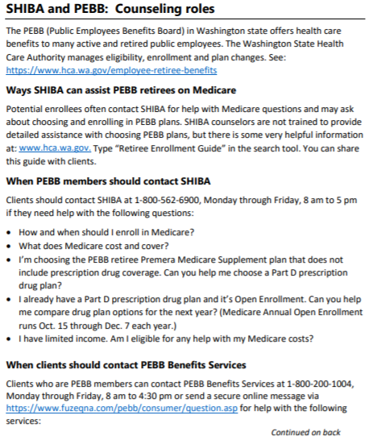
Page 1 of 2
See the job at https://www.insurance.wa.gov/sites/default/files/documents/shiba-pebb.pdf.
Notes:
SHIBA trainers
See SHIBA Job Aid: https://www.insurance.wa.gov/sites/default/files/documents/shiba-pebb.pdf

Slide 21
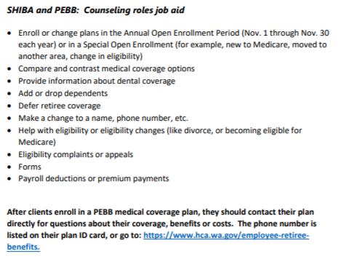
Page 2 of 2
See the job at https://www.insurance.wa.gov/sites/default/files/documents/shiba-pebb.pdf.
Notes:
SHIBA trainers
See SHIBA Job Aid: https://www.insurance.wa.gov/sites/default/files/documents/shiba-pebb.pdf

Slide 22
PEBB: Discussion activity
Your trainer may lead an activity to discuss working with clients who have questions about PEBB.
Public Employees Benefits Board https://www.hca.wa.gov/about-hca/public-employees-benefits-board-pebb-program
See the notes section of this slide for the discussion activity.
The next slide provides referral resources.
See the SHIBA job aid SHIBA and PEBB: Counseling roles which provides info on what you can do. https://www.insurance.wa.gov/sites/default/files/documents/shiba-pebb.pdf
Notes:
SHIBA trainers
This is an optional activity to discuss working with clients who have questions about PEBB.
PEBB Open Enrollment is November 1 to November 30.
Discussion: What can you tell a client about SHIBA’s assistance for a person who has PEBB retiree benefits?
Some suggestions:
If they have the Premera Medigap Plan F or G, they should compare Part D plans yearly, just like any other Medicare beneficiary. SHIBA can help with this.
HCA posts lots of information about options on their web site: https://www.hca.wa.gov/employee-retiree-benefits/retirees
Two helpful documents:
The “For Your Benefit” PEBB newsletter-Retiree Edition. Sent to all retirees. The October edition will cover OEP options.
The PEBB Retiree Enrollment Guide. The 2022 edition should be available in October 2021.
Questions:
Clients can try to get their questions answered on the PEBB web site first but may need to call the PEBB- 800-200-1004 to verify. We are sorry, but we know if no way to get them to answer any more quickly. Suggest calling early and not waiting until late November.
If clients have specific questions about the PEBB health plans, they should call the plans directly. The numbers are on the PEBB web site.

Slide 23
PEBB: Resources
PEBB Retiree Health Coverage Resources
Health Care Authority
https://www.hca.wa.gov/employee-retiree-benefits/contact-us
1-800-200-1004
Send a secure message: https://www.fuzeqna.com/pebb/consumer/question.asp
Department of Retirement Systems
https://www.drs.wa.gov/
360-664-7000
Toll-free: 1-800-547-6657
Webinars and videos: https://www.drs.wa.gov/retirement-planning/seminar/ Scroll down the page to view “Health Care in Retirement” video.
Continued

Slide 24
PEBB: Resources (cont’d)
PEBB Retiree Health Coverage Resources
HCA page with links to information about retiree health insurance:
https://www.hca.wa.gov/employee-retiree-benefits/retirees
PEBB Retiree Enrollment Guide: https://www.hca.wa.gov/assets/pebb/51-0205-retiree-enrollment-guide-2021.pdf
Monthly retirement seminars including overview of retiree health insurance: https://www.hca.wa.gov/employee-retiree-benefits/retirees/attend-retirement-webinar

Slide 25
Plan Finder

Slide 26
Plan Finder: Webinar updates
As of August 20, 2021:
CMS NTP held a Train-the-Trainer workshop on 8/19/21 which has a great overview.
The training slides are available now on My SHIBA and CMS.
https://www.insurance.wa.gov/media/10229 (PowerPoint)
See the next slide for a webinar summary.
The recorded webinar should be posted on CMS.
Visit https://cmsnationaltrainingprogram.cms.gov/ for more information.
Search for “Medicare plan finder.”
Look through the search results for “Workshop: Medicare Plan Finder (Recorded August 19, 2021).
Continued
Notes:
SHIBA trainers
At the time of developing these materials in August 2021, the links from this slide were posted on the CMS NTP website, however, the link to the recording was not active.

Slide 27
Plan Finder: Webinar updates (cont’d)
Webinar Summary
If people log into their Medicare accounts to use Plan Finder, it will automatically save their preferred pharmacy in addition to their prescription drugs.
The Insulin Savings filter has been removed (as of 8/19). You’ll now just search for the lowest premium + drug costs filter for best priced plans.
Plan comparison: comparing 3 plans has been improved for mobile users and format for printing results has been improved.
Out-of-network/preferred pharmacies: you will have to click on plan details to find out which pharmacies are out-of-network or preferred. When you click on a plan’s details, it will list all in-network and preferred pharmacies for those plans.
CMS is working on developing a “SHIP specific view” of Plan Finder which will allow SHIP/SHIBA volunteer to access a client’s Medicare account using the client’s Medicare number (instead of using the client’s Medicare account login). CMS is developing a login for SHIP/SHIBA volunteers; stay tuned for more info.
Notes:
SHIBA trainers
This slide provides an overview of highlights from the 8/19/21 CMS NTP Webinar
Thanks to Sarah Clark for providing some notes.
Some enhancements won’t happen until sometime in September 2021, and in the case of the SHIP-specific view, that will be launched later.

Slide 28
Group activity: Plan Finder review
Your trainer may present one of the following Plan Finder activities:
1. Present and demonstrate using Plan Finder.
www.medicare.gov/plan-compare/#/?lang=en
2. Watch the YouTube demo (about 15 minutes)
https://www.youtube.com/watch?app=desktop&v=QgXmY8-gEHk
3. Review of August 19, 2021 NTP training materials
Notes:
SHIBA trainers
Optional: Discuss as a group or use the Zoom breakout room option to discuss in smaller groups.
Regarding #2 about the YouTube demo, the presenter at the NTP Train-the-Trainer webinar on 8/19 said that CMS may update this video to show the updated system. No ETA has been announced.
Mechanics of Plan Finder: Using, playing with it, practice, and how to maximize your
time on Plan Finder.
Mechanics of Plan Finder
Practicing Plan Finder.
Perhaps develop a Zoom recording.

Slide 29
Optional practice sessions: Communicating with clients to complete enrollment
Notes:
SHIBA trainers
This section is optional. Plan Finder work sheets that you can use for practice are located on My SHIBA with the curriculum materials for September 2021 training.

Slide 30
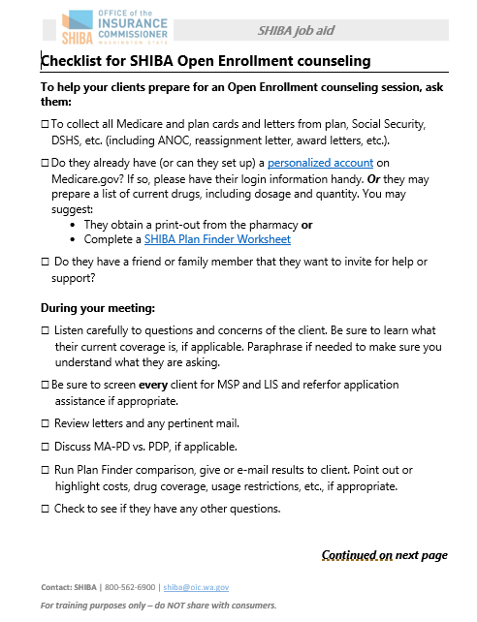
Job aid: OE counseling checklist
Checklist for SHIBA open enrollment counseling
Your trainer may lead you in an optional activity.
Two pages
https://www.insurance.wa.gov/media/1542
A larger version is on the next two slides.
The full-sized version is located on My SHIBA.
Notes:
SHIBA trainers
The Checklist for SHIBA Open Enrollment counseling is a job aid to help volunteers with getting their clients prepared for a structured counseling session.
Activity suggestion: Discuss how your group might use and share these OEP publications with clients.
How to set up a personalized Plan Finder account: https://www.insurance.wa.gov/sites/default/files/documents/plan-finder-account-creation.pdf
SHIBA Plan Finder Worksheet: https://www.insurance.wa.gov/sites/default/files/documents/medicare-planfinder-worksheet.pdf
Your SHIBA Medicare Action Plan: https://www.insurance.wa.gov/sites/default/files/documents/shiba-medicare-action-plan_0.pdf
The Open Enrollment counseling checklist may be found by doing a search on My SHIBA for “Open Enrollment counseling checklist.”
You may either link to the SHIBA version of the document or use the versions on the next two slides for reference in case you are unable to access the My SHIBA site.

Slide 31
Page 1 of 2
https://www.insurance.wa.gov/media/1542
Notes:
SHIBA trainers
The Checklist for SHIBA Open Enrollment counseling is a job aid to help volunteers with getting their clients prepared for a structured counseling session.
Activity suggestion: Discuss how your group might use and share these OEP publications with clients.
How to set up a personalized Plan Finder account: https://www.insurance.wa.gov/sites/default/files/documents/plan-finder-account-creation.pdf
SHIBA Plan Finder Worksheet: https://www.insurance.wa.gov/sites/default/files/documents/medicare-planfinder-worksheet.pdf
Your SHIBA Medicare Action Plan: https://www.insurance.wa.gov/sites/default/files/documents/shiba-medicare-action-plan_0.pdf

Slide 32
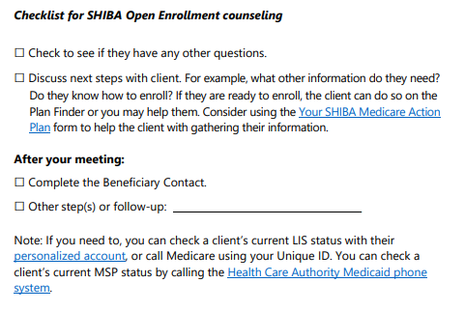
Page 2 of 2
https://www.insurance.wa.gov/media/1542

Slide 33
Practice: Plan Finder scenarios
Your trainer may lead a discussion based on three Plan Finder Practice scenarios.
See the scenarios and discussion instructions on the next slide.
Questions to consider are located in the notes portion of the slide.
The scenario worksheets are also located on My SHIBA with the September 2021 continuing education materials.
Reference: Medicare Plan Finder worksheet https://www.insurance.wa.gov/media/8042
Continued
Notes:
SHIBA trainers
This is an optional discussion with three training scenarios.
See the slide that goes with these notes for more information.
Training scenarios are also posted on MySHIBA.
Use the Medicare Plan Finder worksheet as reference for discussion and work on these scenarios.
Questions to consider are in the notes on the next slide as well as on the PDFs posted on My SHIBA.

Slide 34
Practice: Plan Finder scenarios (cont’d)
Shelley wants to compare Part D plans to see if she should change for 2022.
Carlos wants to save as much money as he can. You have screened him, and he might be eligible for Extra Help. Can you find the possible costs with and without Extra Help?
Jin is interested in drug coverage and additional benefits in a Medicare Advantage plan in your county (if applicable).
Notes:
SHIBA trainers
Notes: Please see the three Plan Finder practice scenario sheets with lists of drugs for Shelley, Carlos and Jin located on My SHIBA with the September 2021 continuing education curriculum documents.
Reference: Medicare Plan Finder worksheet https://www.insurance.wa.gov/sites/default/files/documents/medicare-planfinder-worksheet.pdf
Questions to consider:
What do you do if the Plan Finder shows a Generic version of the drug?
What do you do if you can’t find the drug on the Plan Finder?
What if you know (or learn) the drug is over-the-counter?
What do you do if you know (or learn) the drug is covered by Medicare Part B?
What do you do if the Plan Finder tells you there is Prior Authorization, Quantity Limits or Step Therapy for a certain drug?
If your county has Medicare Advantage plans, how do you show your client the costs for medical care? How do you show your client how to understand the additional benefits the plan may offer?

Slide 35
Practice: Sharing Plan Finder results
Your trainer can demonstrate ways to save and share Plan Finder results.
Activity: See the next two slides for information on how to save Plan Finder results and send as an email or attach to a STARS beneficiary contact (BC).
Questions:
What information do you share with a client?
How do you explain the results to a client?
Continued
Notes:
SHIBA trainers
Demonstrate saving Plan Finder results.

Slide 36
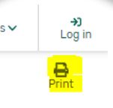
Practice: Sharing Plan Finder results (cont’d)
1. From a Plan Finder results webpage, click the PRINT icon in the upper right of the webpage. See the example below, which is circled on the right and then enlarged. https://www.medicare.gov/plan-compare
Notes:
SHIBA trainers
You may access Medicare.gov to demonstrate a plan compare which may give a better view of these slide examples.

Slide 37
Practice: Sharing Plan Finder results (cont’d)
2. Select: Save as PDF.
3. Click: Save.

Slide 38
Practice: Sharing Plan Finder results (cont’d)
4. Save and send the PDF Decide where to save it
Desktop is a good option
Your computer may work differently
Name the file in a way you can identify it
Example: PF Results J Smith 10-20-21
5. Decide how to send it
Attach to an email
Print and mail
Group question: Are there other ways to share this info?

Slide 39
Practice: Communicating results
Activity: Your trainer may lead an activity in breakouts or as a group.
Share how you would counsel a client to explain the following Plan Finder results:
Estimated annual costs.
Are all drugs on the formulary?
Any restrictions?
Costs at different pharmacy or “preferred” pharmacies.
Continued
Notes:
SHIBA trainers
Practice Sessions: Lead an activity to help volunteers in communicating Plan Finder results and next steps with a client.
Additional resource from CMS: https://www.medicare.gov/Pubs/pdf/11163-Compare-Medicare-Drug-Coverage.pdf
Effectively communicating with clients to complete enrollment
Items to cover include:
Here is your confirmation number, keep it, it’s important.
You should receive a welcome packet. It should be in about 10 days.
Look in the mail for things from your plan. Might look like junk but there will be info like formulary, websites, info, member id…don’t throw this stuff away. It might be needed in the future.

Slide 40
Practice: Communicating results (cont’d)
Activity: Share how you would counsel a client to explain the following Plan Finder results:
Costs and Maximum Out-of-Pocket for a Medicare Advantage plan if applicable.
Next steps clients can take.
Call plan for more information.
Enroll in plan.
Notes:
SHIBA trainers
Practice Sessions: Lead an activity to help volunteers in communicating Plan Finder results and next steps with a client.
Effectively communicating with clients to complete enrollment
Items to cover include:
Here is your confirmation number, keep it, it’s important.
You should receive a welcome packet. It should be in about 10 days.
Look in the mail for things from your plan. Might look like junk but there will be info like formulary, websites, info, member id…don’t throw this stuff away. It might be needed in the future.

Slide 41
Practice: Sharing Plan Finder results
The most efficient way to share Plan Finder results is by using email.
Discuss other ways to share results:
When meeting with a client in-person.
By U.S. mail.
Notes:
SHIBA trainers
Lead a discussion on other ways to share Plan Finder results with a client.

Slide 42
Resources to support you during OEP

Slide 43
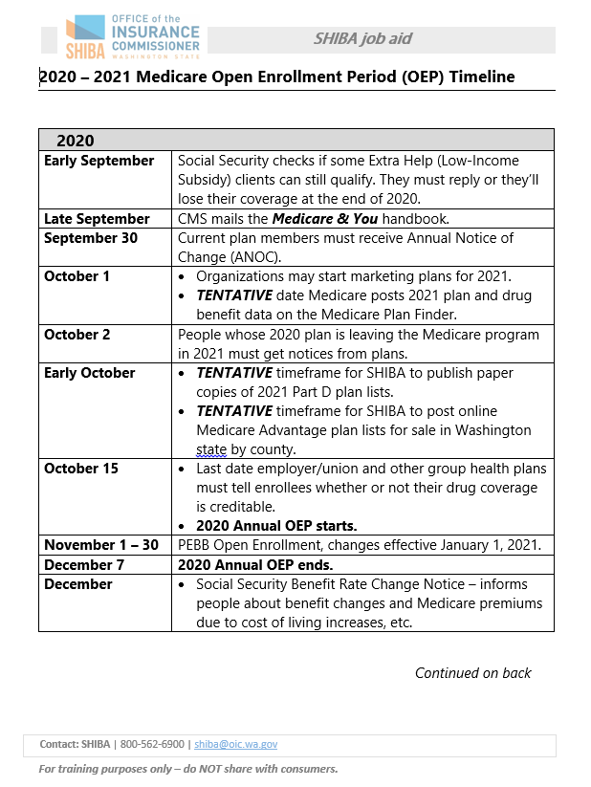
September 2021 resources
Medicare & You 2021 and 2022
Partner publication www.medicare.gov/Pubs/pdf/10050-medicare-and-you.pdf
Audio file and podcast information for ordering: https://downloads.cms.gov/media/medicare/pub/01-Welcome-to-Medicare-and-You-2021.mp3
2021-2022 Medicare Open Enrollment Period (OEP) timeline
SHIBA job aid
https://www.insurance.wa.gov/media/6901
2 pages

Slide 44
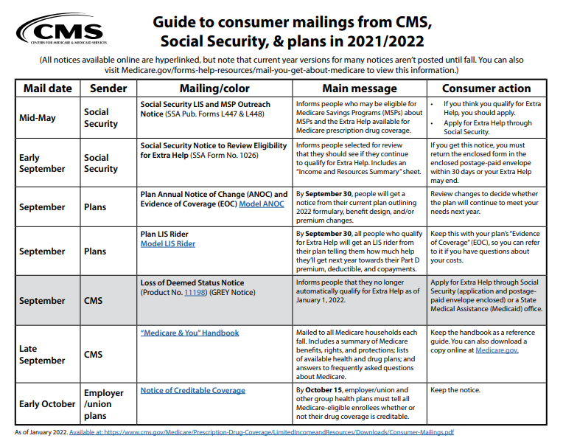
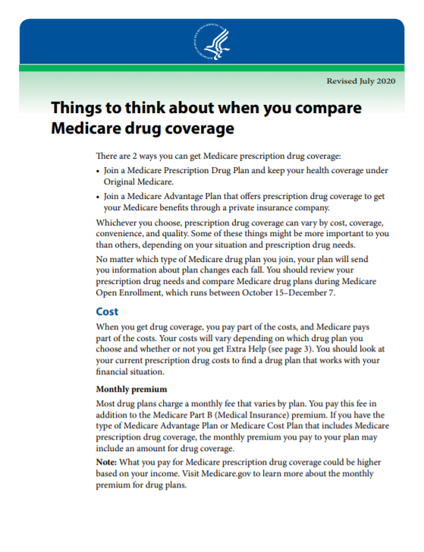
September 2021 resources
CMS Guide to consumer mailings
Partner publication
www.cms.gov/Medicare/Prescription-Drug-Coverage/LimitedIncomeandResources/Downloads/Consumer-Mailings.pdf
Five pages
Things to think about when you compare Medicare drug coverage
https://www.medicare.gov/Pubs/pdf/11163-Compare-Medicare-Drug-Coverage.pdf
Eight pages

Slide 45
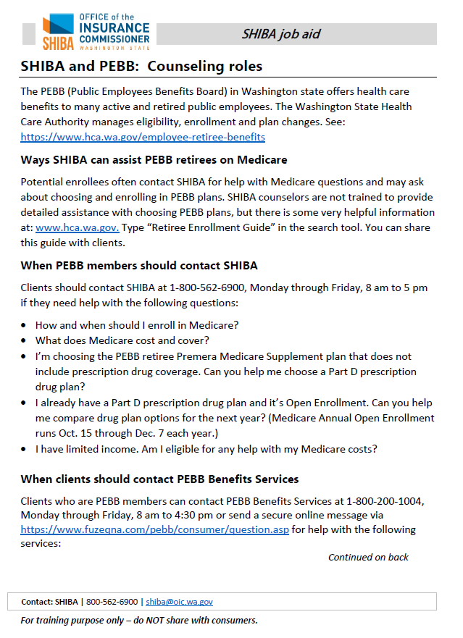
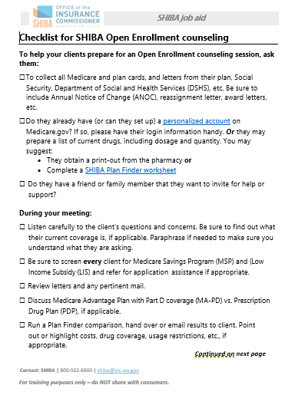
September 2021 resources
SHIBA and PEBB: Counseling roles
SHIBA job aid https://www.insurance.wa.gov/media/6116
Two pages
Checklist for Open Enrollment counseling
https://www.insurance.wa.gov/media/1542
Two pages

Slide 46
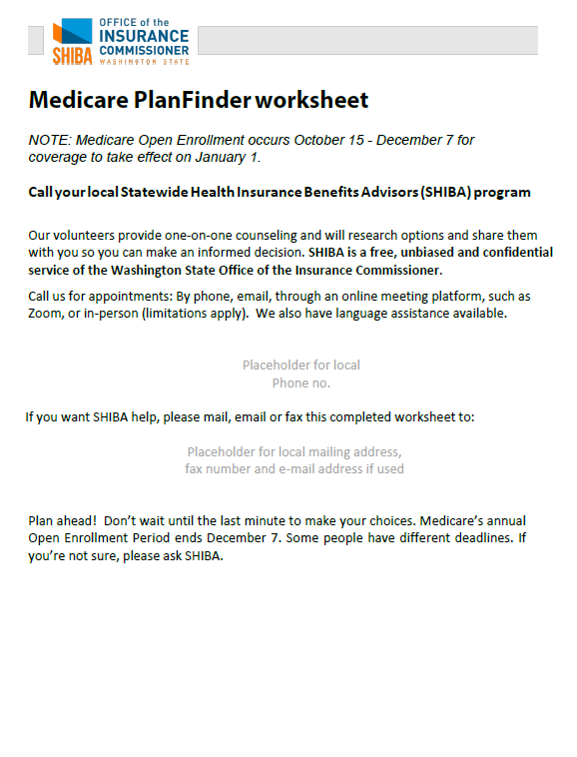
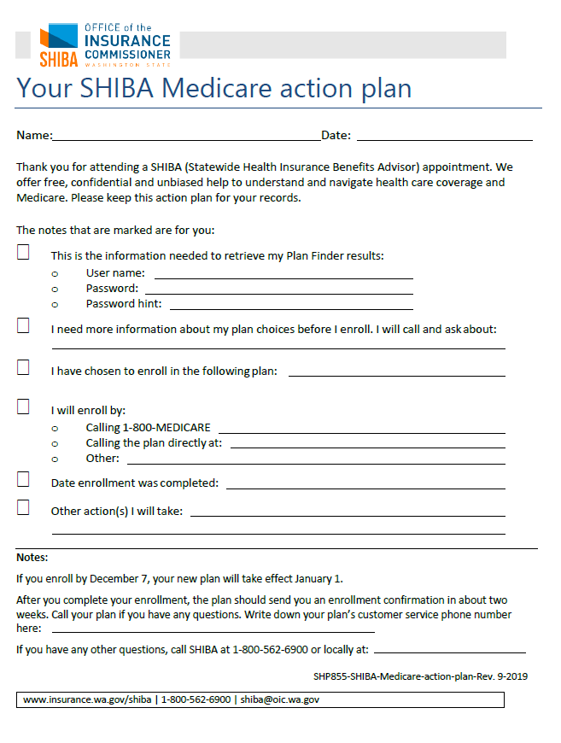
September 2021 resources
Medicare Plan Finder worksheet
SHIBA client publication
Search My SHIBA for “planfinder worksheet” www.insurance.wa.gov/media/8042
Four pages
Your SHIBA Medicare action plan (SHP 855)
SHIBA client publication https://www.insurance.wa.gov/media/1541
One page

Slide 47
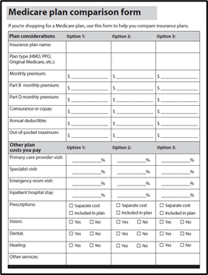
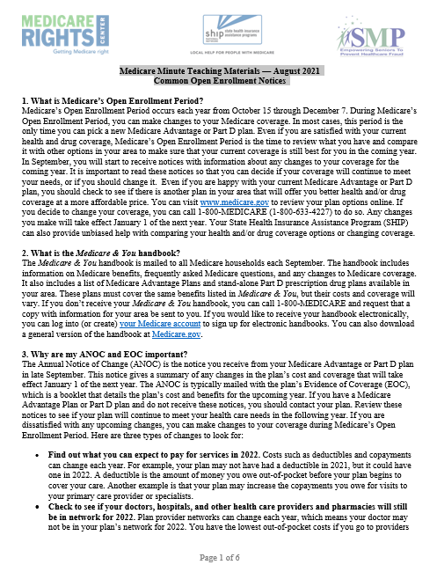
September 2021 resources
Medicare plan comparison form (SHP838)
SHIBA client publication
www.insurance.wa.gov/sites/default/files/documents/medicare-plan-comparison-form_2.pdf
Two pages
Medicare Minute Teaching Materials
Common Open Enrollment Notices
August 2021
https://www.insurance.wa.gov/sites/default/files/documents/common-open-enrollment-notices.pdf

Slide 48
September 2021 resources
Guide to ordering publications through Fulfillment
Step-by-step instructions for ordering publications and have them directly mailed to you or a client.
SHIBA client publication
https://www.insurance.wa.gov/sites/default/files/documents/order-publications-guide.pdf
Ten pages

Slide 49
September 2021 resources
CMS NTP Virtual Workshop: Medicare Plan Finder
Webinar from August 19, 2021
https://www.insurance.wa.gov/media/10229 (PowerPoint) or
https://cmsnationaltrainingprogram.cms.gov/moodle/course/view.php?id=147 (login may be required)
Log into https://cmsnationaltrainingprogram.cms.gov and search for “CMS NTP Virtual Workshop: Medicare Plan Finder.”

Slide 50
SHIP TA: Webinars and materials
SHIP TA offers many training sessions and webinars along with providing a library of training materials.
Here is one offering for September:
Using Your CMS Unique ID Webinar
Wednesday, September 22, 2021 | 2:30 pm - 4:00 pm ET
SHIP National Technical Assistance Center (SHIP TA Center)
info@shiptacenter.org | 1-877-839-2675 | www.shiptacenter.org
Notes:
Webinar description: The Centers for Medicare & Medicaid Services (CMS) Unique ID system is available to State Health Insurance Assistance Programs (SHIPs) and Senior Medicare Patrol (SMP) programs through a collaboration between the Administration for Community Living (ACL) and CMS. The system is designed to remove barriers to researching beneficiaries’ complex Medicare issues.
CMS Unique IDs are used by active, approved, screened, and trained SHIP and SMP team members to contact Medicare, participating Medicare plans, and the Benefits Coordination & Recovery Center (BCRC) for CMS. They serve as a form of verification to provide access to certain beneficiary information when assisting Medicare beneficiaries.
This webinar will provide training for SHIP and SMP representatives with CMS Unique IDs about how to use their IDs.
Speakers:
Maggie Flowers, Administration for Community Living
Marissa Whitehouse, Administration for Community Living
Ginny Paulson, SHIP Technical Assistance Center
Heather Flory, SMP Resource Center
Audience: This webinar is intended for SMP and SHIP team members who need to know how to use their CMS Unique IDs. This includes SHIP counselors who have been assigned a CMS Unique ID.

Slide 51
CE topics and evaluation

Slide 52
2021-2022 training schedule
2021
October: Are we ready?
No NEW training topics for October.
Bring and share late-breaking information.
What still must be done in our area to get ready?
Reviewing gaps and questions.
Support and case-sharing.
November and December: No training--it’s Open Enrollment!
2022
January: Happy new year!
Continuing Ed topics to be announced.

Slide 53
Evaluation
Your responses help us to improve SHIBA’s training program.
Did you find today’s training helpful or useful for your SHIBA counseling or outreach?
What would have made this training better for you?
Please take some time to send thoughts to shiba@oic.wa.gov, dianas@oic.wa.gov or to your trainer.
We appreciate your feedback!

