Slide 1
Washington State Reentry Demonstration Initiative
OIC Briefing
June 18, 2024
Notes:
: Mich’l to kick things off,

Slide 2
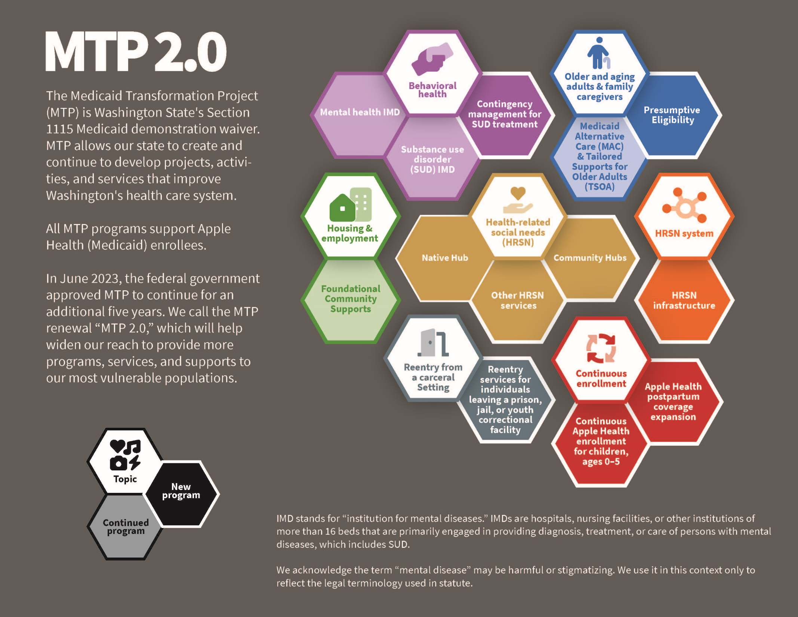
Notes:
Emma

Slide 3
Reentry Initiative goals
Prepare people for a successful transition and reentry into their community and help them live their healthiest life.
Improve health outcomes and reduce recidivism, emergency department visits, overdoses, and death.
Support substance use disorder and recovery and target infectious diseases like Hepatitis C before a person’s release.
Stabilize and treat other conditions before a person’s release, so they can reenter their community as healthy as possible.
Notes:
Emma

Slide 4
Pre-release services
First three pre-release services are mandatory; next four are optional:
Case management
Medications for alcohol and opioid use disorder
30-day supply of medications and medicaI supplies at release
Medications during the pre-release period
Lab and radiology
Services by community health workers with lived experience
Physical and behavioral clinical consultations
Notes:
Emma

Slide 5
Working with Facilities
What must carceral facilities do to participate?

Slide 6
Meet cohort milestones
Submit an Intent to Participate form.
This initiates capacity building funding and completes Milestone 1.
Complete a Capacity Building Application, which includes an Implementation Plan.
Complete a Readiness Assessment.
Submit an Interim Progress Report.
Submit a Final Progress Report.
Notes:
Tyron

Slide 7
Cohorts
The Reentry Initiative will launch at different times for participating facilities.
Facilities choose to participate in 1 of 3 implementation cohorts, based on their readiness.
Cohort 1—the first group of carceral facilities implementing the Reentry Initiative—will launch and start billing Medicaid on July 1, 2025.
Cohort 2: January 1, 2026
Cohort 3: July 1, 2026
Notes:
Tyron

Slide 8
Milestones, cohorts, & go-lives
 | 1) Intent to Participate form | 2) Implement. Plan | 3) Readiness Assessment | Go-live with pre-release services | 4) Interim Progress Report | 5) Final Progress Report
Cohort 1 | June 1, 2024 | Oct. 1, 2024 | March 1, 2025 | July 1, 2025 | May 1, 2026 | Oct. 1, 2026
Cohort 2 | Nov. 1, 2024 | April 1, 2025 | Sept. 1, 2025 | Jan. 1, 2026 | Dec. 1, 2026 | May 1, 2027
Cohort 3 | May 1, 2025 | Oct. 1, 2025 | March 1, 2026 | July 1, 2026 | May 1, 2027 | Oct. 1, 2027
Notes:
Tyron

Slide 9
Maximum funding by facility
Facility population | Maximum funding for reentry planning and process | Maximum funding for IT infrastructure
Tier 1 (1-49) | $1M | $1M
Tier 2 (50-249) | $1.25M | $1M
Tier 3 (250-1,000) | $1.5M | $1M
Tier 4 (More than 1,000) | $1.75M | $1M
Notes:
Tyron

Slide 10
Capacity building funding for Milestone 1, Cohort 1
Milestone | Capacity building funding | IT funding | Timing for Cohort 1
1) Intent to Participate form | 10% of total capacity building funding upon submission: Tier 1 (1-49): $100,000 Tier 2 (50-249): $125,000 Tier 3 (250-1,000): $150,000 Tier 4 (more than 1,000): $175,000 | N/A | Due date: June 1, 2024 Funding paid: July 2024
Notes:
Tyron

Slide 11
Resources
Visit our Reentry from a carceral setting page including FAQ
Read the:
Invitation to participate
Reentry Initiative overview
The Intent to Participate form
Email our team at HCAReentryDemonstrationProject@hca.wa.gov
Notes:
Tyron

Slide 12
Thank you!

