Slide 1
Medicaid and Medicare working together in Washington state
Washington SHIBA version – February 2019
For training purpose only – not for distribution to the public
Created Jan. 10, 2019
Notes:
RTCs NOTE: Please note that this version does not have the notes. The corrected notes are in the portrait version sent as a part of trainer notes.
This version of the Power Point is ONLY for presentation of the slides for training purposes only.
-Diana 1/17/19

Slide 2
Learning objectives
Describe how Medicare and Medicaid work together for someone who has both
Articulate SHIBA volunteers’ role in screening and helping people apply for Medicaid or any of the Medicare Savings Programs or Extra Help
Describe the partner agencies and resources SHIBA volunteers can access when confronted with complex Medicare and Medicaid issues
Show volunteers how to use the Extra Help tri-fold and/or Rainbow chart to screen clients for public assistance programs
Define what the Spenddown program is and how to refer clients when they have questions about it

Slide 3
SHIBA scope
SHIBA volunteers should be knowledgeable about all aspects of Medicare and what is covered in the Medicare & You handbook.
We SCREEN and REFER to apply for Medicaid and related programs, such as:
Medicare Savings Program (MSP)
Extra Help
We help people NAVIGATE Medicare and understand their coverage options
We send people with problems to the right place to get help
We help people to be their own best advocates

Slide 4
Medicaid is “Washington Apple Health”
Nationally Medicaid is medical assistance for people with limited income and resources.
Federal and state funded programs
Each state runs its own Medicaid program with Federal oversight.
States have some discretion on how benefits are structured and delivered.
Washington Apple Health is an umbrella term or “brand name” for all Washington state medical assistance programs, including Medicaid.
The Health Care Authority (HCA) administers most Washington Apple Health programs.
The Department of Social and Health Services (DSHS) administers the Classic Medicaid programs.

Slide 5
Medicaid reference for SHIBA
HCA Publication 23-315
https://www.hca.wa.gov/assets/free-or-low-cost/22-315.pdf

Slide 6
Eligibility overview
The guide gives an overview of eligibility requirements for Washington Apple Health. It doesn’t include every requirement or consider every situation that might arise.
There are many different Medicaid programs with many different eligibility requirements.
We will focus on programs that people with Medicare may have.

Slide 7
“Classic Medicaid”
The term used to describe the Medicaid health care programs administered by the Department of Social and Health Services (DSHS).
People on Medicare might get these:
SSI-Related Medicaid
Spenddown/Medically Needy
Medicare Savings Programs
Long-term services and supports
Most of these programs have both income and resource limits

Slide 8
People with Medicare & Medicaid
Thousands of people are age 65 or older or under 65 and on Medicare due to disability
AND
Also qualify for some kind of Medicaid program due to limited income and resources or functional impairment with a need for long term supports and services

Slide 9
People with both = Dual Eligibles
Duals have both Medicare and Medicaid.
If a Medicare beneficiary also has Medicaid then Medicare always pays first. Medicaid is second payer, or the payer of last resort if there’s another insurance (i.e. an employer or retiree health plan).
Once on Medicare, claims are processed FIRST by Medicare A or B or their MA plan (Part C).
Once on Medicare, outpatient prescriptions are not covered by Medicaid, but by Part D or MA-PD.
A few drugs that Medicare cannot pay for may be paid by Medicaid.
For example, some over the counter (OTC) drugs

Slide 10
Dual clients get a Provider One Services Card
Provider One is Washington’s billing system that pays providers for services to clients. To replace the card, call the HCA at 1- 800-562-3022.

Slide 11
Review the Rainbow chart

Slide 12
SSI-Related medical eligibility
Must be a WA resident
Must be 65+ (“aged”)
OR blind or disabled (as defined by SSA)
Under income limit $750.00 (same as SSI standard)
Under Resource limit
Must be Citizen, National, Qualified Alien*
Note:
We will update the Rainbow chart with 2019 income limits soon.
The Rainbow chart adds $20 per household (“Income Disregard”)
*Exempt from five-year bar or have met the five-year bar

Slide 13
SSI-Related Medical
The benefit is Full Medicaid
Also known as “Categorically Needy” or CN
Sometimes called ABD (Aged, Blind, Disabled) Medicaid or S01 and S02 by DSHS
RAINBOW Chart tells what action to take and what it covers
MAY also have Medicare
If 65 or older
If under age 65 and also on SSDI for 2+ years
MAY NOT also have Medicare
If under age 65 and not on SSDI for 2+ years

Slide 14
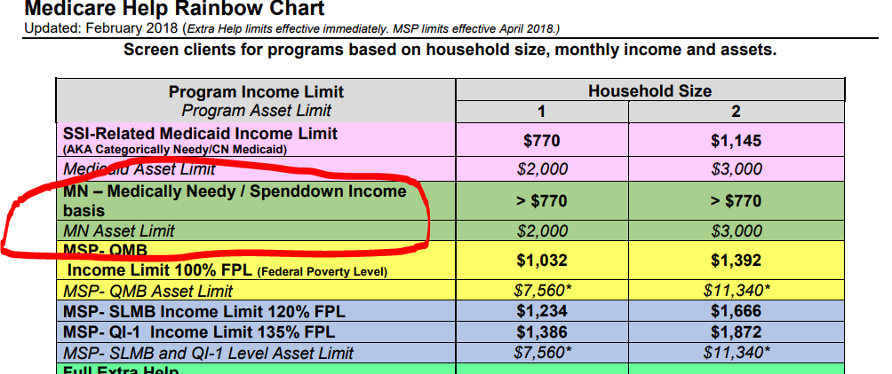
Medically Needy (MN) and Spenddown
The Medically Needy (MN) program is a federal and state-funded Medicaid program for individuals who are aged, blind, disabled, pregnant, or a child with income above the applicable CN limits. MN provides slightly less health care coverage than CN and requires greater financial participation by the individual.
We will focus on the MN program for people who are aged, blind and disabled.

Slide 15
Spenddown calculation example
Example: Mark is single, he receives $1070/month in Social Security Benefits. He has no earned income. He has less than $2000 in assets.
$1070
-20 minus unearned standard income deduction
$1050 countable income or ‘net income’
-$750 minus the state income limit MN one person
$300 per month “excess income”

Slide 16
Spenddown – base periods
The base period is the number of months used to calculate the spenddown liability amount
Base periods can be selected in either 3 or 6 month increments
An individual may also request retroactive coverage for any or all of the 3 months prior to the month of application
Slide content from DSHS Community Services Division

Slide 17
How DSHS calculates spenddown
Using the previous example, the client had $300 per month in excess income
Spenddown liability would be calculated as:
For a 3-month base period: $900 ($300 x 3)
For a 6-month base period: $1800 ($300 x 6)
Slide content from DSHS Community Services Division

Slide 18
Meeting the spenddown
Clients can either provide proof they:
Owe their spenddown amount in out-of-pocket costs
Paid their spenddown amount in out-of- pocket costs
Paid Medicare Part A, B, D premiums (unless on MSP)
Clients must send this information to DSHS in envelope provided.
Slide content from DSHS Community Services Division

Slide 19
Resources for spenddown
Clients should call 1-877-501-2233 and ask for the Spenddown Unit. They will get a call back within 24-48 hours in the order that we receive.
Have Provider One or SS# and question ready
Handout: See the one page “What is a Medicaid Spenddown and how is it figured?”

Slide 20
Medicare Savings Programs
Medicare Savings Programs (MSP) pay the Medicare premiums and sometimes deductibles/co-insurances and co-payments
Medicare Savings Programs have an income and resource limit.
If a person qualified for QMB, SLMB or a QI program, they automatically qualify for Extra Help for prescriptions
Slide content from DSHS Community Services Division

Slide 21
Medicare Savings Eligibility

Slide 22
Qualified Medicare Beneficiary (QMB)
Known as S03 Medical Program in ACES by DSHS
QMB pays for Part A and/or Part B premium; providers aren’t allowed to bill client for deductibles, coinsurance and copayments when client gets services and supplies except outpatient prescriptions.
Client needs to show Medicare or Medicare Advantage and Provider One Services Card to all providers and suppliers
The client’s providers must be contracted with both Medicare and Medicaid

Slide 23
QMB continued
Enrollment starts first of the month following the month eligibility is documented
Benefits covered: (Works much like a Medigap Plan F)
Hospital deductibles
SNF copays or co-insurance: days 21-100 ($170.50 daily)
Part A monthly premium (up to $437)
Part B annual deductible ($185)
Part B or C coinsurance or co-pays

Slide 24
QMBs and provider billing
When a person has Medicare and is on QMB the providers are prohibited from billing any balances to the client.
Except possibly small drug co-pays
If a client gets bills, you can educate them about letting their provider know they have a Provider One card and have QMB. The provider can rebill Medicaid.
If there’s a persistent problem, client can file a complaint with SHIBA.

Slide 25
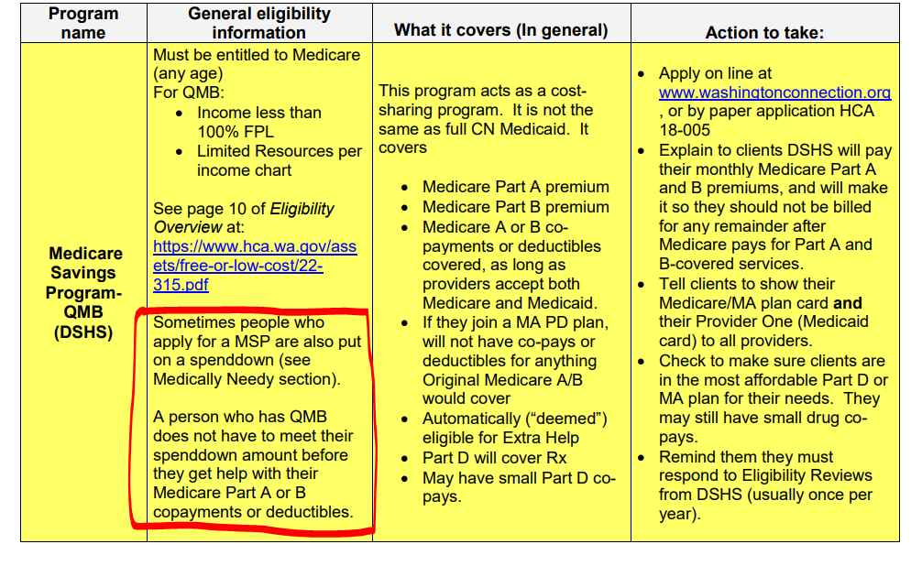
QMB or spenddown?
People may be on QMB and also be put on a Spenddown. QMB takes precedence over Spenddown.

Slide 26
SLMB and QI-1
SLMB is known in ACES as S05
Income less than 120% Federal Poverty Level (FPL)
QI-1 is known in ACES as S06
Income less than 135% FPL
Both pay part B premiums only
Main difference is person must apply each year for QI benefits as applications are granted on first-come, first-served basis

Slide 27
What is Extra Help?
Program to help people pay for Medicare prescription drug costs (Part D)
Also called the Low-income subsidy (LIS)
People with the lowest income and resources
Pay no premiums or deductible, and small or no copayments
People with slightly higher income and resources
Pay reduced deductible and a little more out of pocket
No coverage gap (donut-hole) or late enrollment penalty (LEP) if you qualify for Extra Help
Application is through SSA.gov

Slide 28
Medicaid/MSP and Extra Help
If a person on Medicare is found eligible for Medicaid and/or Medicare Savings Program they will be eligible for Extra Help.
They will be notified by SSA they are eligible without having to file an application.
This is called being “deemed” as eligible
Client will get a “purple letter” from CMS
Filing both the MSP and the LIS applications may speed up the process

Slide 29
People who do not need to apply for Extra Help
People on Medicaid
SSI recipients
People with QMB, SLMB or QI-1
Some may not want/need Extra Help for prescription drugs
Example: People with retiree Rx coverage could lose it if they apply for LIS and get auto-enrolled
They can “opt out” of Extra Help

Slide 30
Long-Term Services & Supports (LTSS)
Program names include:
COPES
Community First Choice
Program of All-inclusive Care for the Elderly (PACE)
Nursing Facility Long Term Care
Tailored Supports for Older Adults (TSOA)
Programs include Medicaid coverage
Clients MAY or MAY NOT be on Medicare
People on these programs can have higher income and resources than for SSI-Related Medicaid or Medicare Savings Programs
Must meet financial eligibility and also have a functional assessment of care needs to qualify

Slide 31
LTSS
Services are tailored to fit individual needs and situations.
Services may be authorized by DSHS Home and Community Services (HCS) or Developmental Disabilities Administration (DDA).
Services enable people to continue living in their homes with help to meet their physical, medical, and social needs.
When these needs cannot be met at home, care in a residential or nursing facility is available.

Slide 32
Medicaid LTSS services could include:
Adult day care | Occupational therapy
Adult day health | Physical therapy
Caregiver conferences | Substance abuse counseling
Caregiver groups | Skilled nursing care
Client training | Service animal
Transition planning | Transportation services
Environmental modifications | Massage
Home delivered meals | Acupuncture
Personal emergency response systems | Chiropractic
Dietician/nutritionist | Fitness/exercise
Behavioral consultation and technical assistance | Communication therapy

Slide 33
LTSS reference for SHIBA
DSHS Publication 22-619
https://www.dshs.wa.gov/sites/default/files/SESA/publications/documents/22-619.pdf

Slide 34
MAGI Medicaid
MAGI = Modified Adjusted Gross Income
The method used to calculate income and determine household composition for deciding eligibility for Apple Health (includes adults, kids, families, caretaker relatives and pregnant women).
This method follows federal income tax filing rules with a few exceptions and has no resource or asset limits.

Slide 35
Adult MAGI Medical
Part of Medicaid expansion due to Affordable Care Act
MAGI for adults covers people from age 19 – 65
Income under 133% of FPL, no asset limits
Eligibility ends when Medicare begins (regardless of age)

Slide 36
SHIBA helps with transition to Medicare
Medicare now main payer, may be copays, deductibles, etc.
Classic Medicaid rules and programs will now apply
Depending on timing, clients may be “deemed” for Extra Help
Often need help to apply for MSP or Extra Help
May not be eligible if income or assets are too high
Need counseling about Medicare, choosing plans, how to navigate

Slide 37
Warning about Health Homes and MA plans
Health Home clients with Medicare and Medicaid coverage must have Original Medicare for their Part A and Part B benefits. If clients enroll in an MA plan, HCA will automatically disenroll them from Health Home program. This is because they’ll have duplicative care coordination benefits through their Medicare Advantage plan.
If clients want to re-enroll in the Health Home program, they can enroll (quarterly) in a Part D plan, which will disenroll them from their MA plan and they would then have Original Medicare plus Part D coverage. They then would still need to meet the usual Health Home eligibility requirements.
Additional information: www.hca.wa.gov/billers-providers-partners/programs-and-services/health-homes

Slide 38
Eligibility is complex so screen and refer
For example:
Income threshold to qualify for Medicaid is much lower for Medicare beneficiaries than for people not on Medicare.
Household size impacts eligibility (e.g. grandchild)
Help people apply, even if you aren’t sure they’ll qualify
“When in doubt, fill it out”

Slide 39
Where to apply for Classic Medicaid
Online
www.washingtonconnection.org
In-person
Local Community Service Office (CSO)
https://www.dshs.wa.gov/esa/community-services-find-an-office
Group discussion opportunity: Who are your local community partners?
ALTC, ADRC, other staff?

Slide 40
Resources for Classic Medicaid
DSHS Customer Service Contact Center (Classic Medicaid Program): 1-877-501-2233
Client letters for individual situations
Contact HCA to replace Provider One Card or find a provider, submit Medicaid billing complaint, verify coverage: 1-800-562-3022

Slide 41
Some of our shared clients may have Medicaid benefits not covered by Medicare
2019 new hearing aid benefit
Dental
Transportation
Eyewear discount program
What is available to our shared clients is determined by the program they qualify for and their individual needs.

Slide 42
Benefit package varies by program
Sometimes called “Scope of Care”
CN “Categorically Needy”
MN “Medically Needy”
ABP “Alternative Benefits Plan”
Also known as “MAGI Medicaid”
Eligibility Overview has a chart on pages 12 and 13 of the booklet

Slide 43
How to find out what client has

Slide 44
Action steps: How volunteers can use this training
Help clients understand the difference between Medicaid and Medicare
Screen and help clients apply for Extra Help and Medicare Savings Programs
Help clients losing MAGI Medicaid to navigate the change to Medicare
Refer clients to DSHS if they have questions about Spenddown
Refer clients to Home & Community Services if they have questions about LTSS

Slide 45
Thanks to:
Collaborators and advisors included many contacts from HCA, DSHS and ALTSA
Mark Westenhaver
Amy Dobbins
Andy Som
Judith Bendersky and Dale Ensign (SHIBA)

Slide 46
For additional help
For more information, please contact your Volunteer Coordinator, SHIBA Regional Training Consultant or send a note to shiba@oic.wa.gov.
Thank you!

